Slide 1
Chapter 8
Hypothesis Testing
Chapter 11 of 3rd ed.
Chien-Kang Huang (黃乾綱)
臺大工科海洋系

Slide 2
Outline
8.1 Significance Testing
8.2 Binary Hypothesis Testing (11.1)
8.3 Multiple Hypothesis Test (11.2)

Slide 3
Some of the most important applications of probability theory involve reasoning in the presence of uncertainty. In these applications, we analyze the observations of an experiment in order to arrive at a conclusion. When the conclusion is based on the properties of random variables, the reasoning is referred to as statistical inference.
Chapter 7: two types of statistical inference for model parameters:
  Point estimation
  Confidence interval estimation

Slide 4
Two more categories of statistical inference
Significance Testing
  Conclusion Accept or reject the hypothesis that the observation result from a certain probability model H₀
  Accuracy Measure Probability of rejecting the hypothesis when it is true
Hypothesis Testing
  Conclusion The observations result from one of M hypothetical probability models: H₀, H₁, …, H_{M – 1}
  Accuracy Measure Probability that the conclusion is H_{i} when the true model is H_{j} for i, j = 0, 1, …, M – 1.

Slide 5
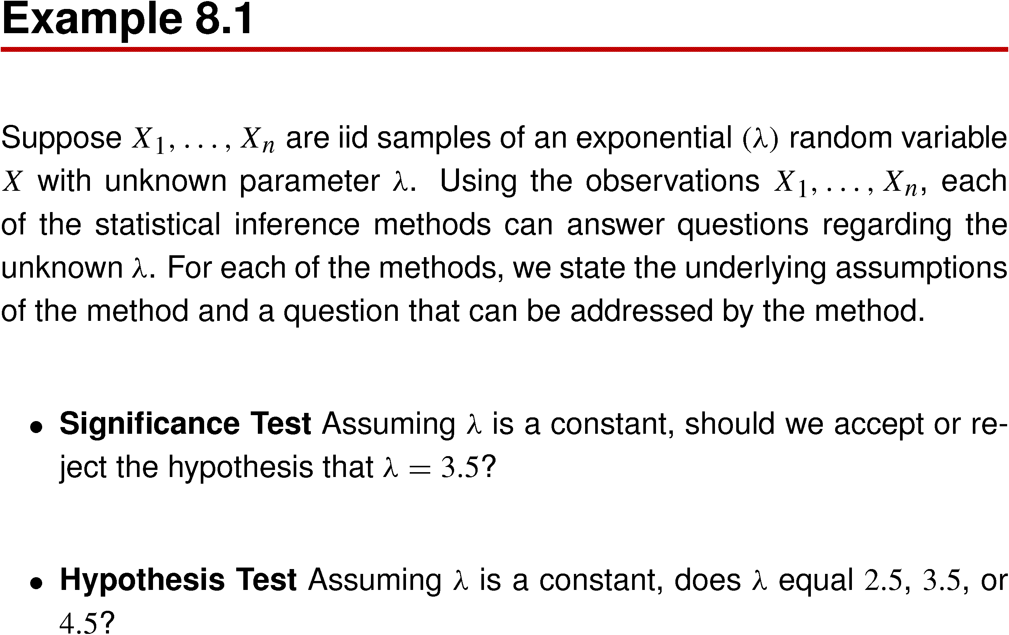
Example 8.1

Slide 6
8.1 Significance Testing

Slide 7

A significance test begins with the hypothesis, H₀, that a certain probability model describes the observations of an experiment. The question addressed by the test has two possible answers: accept the hypothesis or reject it.
The significance level of the test is defined as the probability of rejecting the hypothesis if it is true. The test divides S, the sample space of the experiment , into an event space consisting of an acceptance set A and a rejection set R = A^{C}, if the observation s ∈ A we accept H₀. If s ∈ R, we reject the hypothesis. Therefore the significance level is
To design a significance test, we start with a value of α and then determine a set R that satisfies the equation.

Slide 8
In many application, H₀ is referred to as the null hypothesis.
In these applications there is a known probability model for an experiment. Then the conditions of the experiment change and a significance test is performed to determine whether the original probability model remains valid. The null hypothesis states that the changes in the experiment have no effect on the probability model.

Slide 9
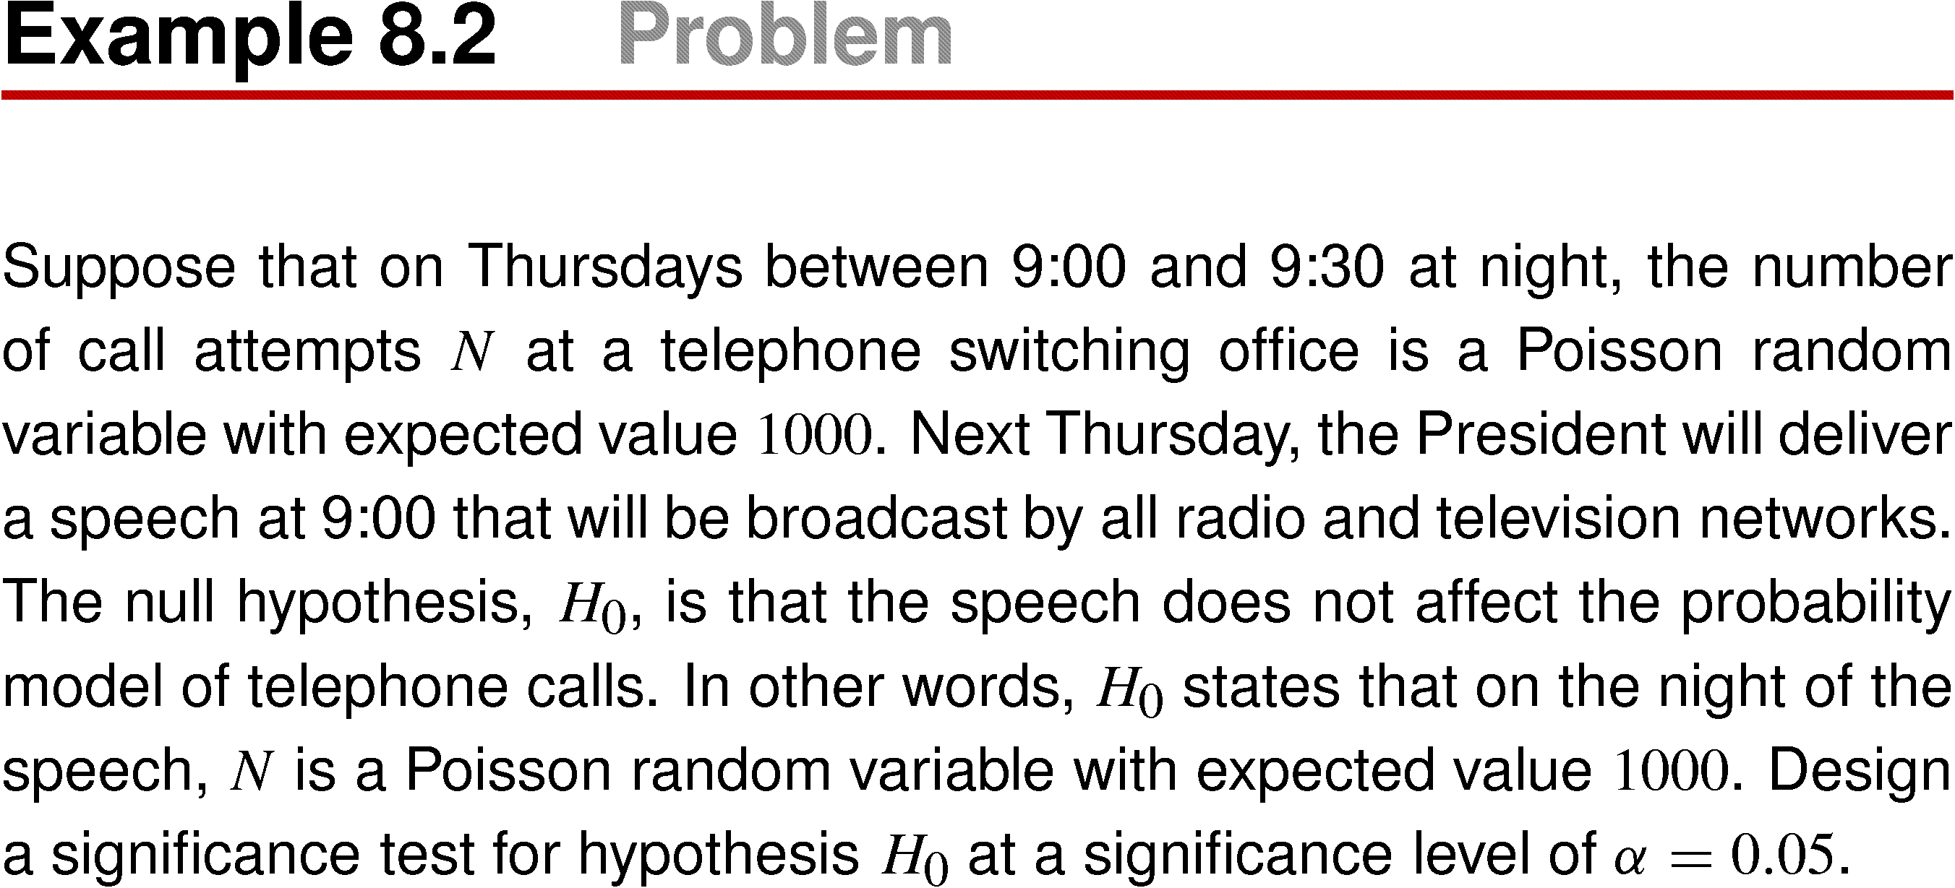
Example 8.2

Slide 10
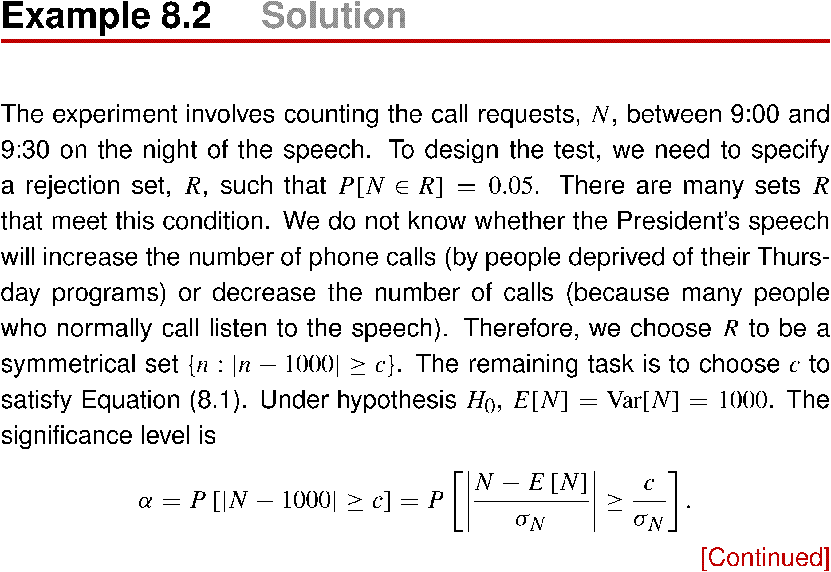
Example 8.2 Solution

Slide 11
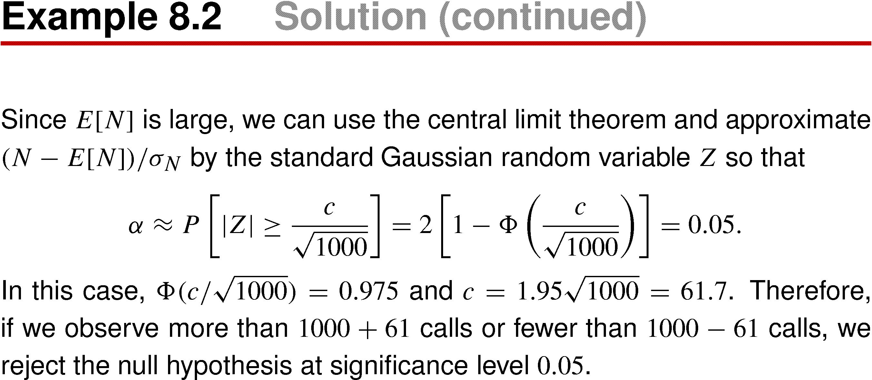
Example 8.2 Solution (continued)
In Experiment 8.2, we implicitly assume that the alternative to the null hypothesis is a probability model with an expected value that is either higher than 1000 or lower than 1000.

Slide 12
In a significance test, two kinds of errors are possible, Statistician refer to them as Type I error and Type II error with the following definitions:
Type I Error False Rejection: Reject H₀, when H₀ is true.
Type II Error False Acceptance: Accept H₀, when H₀ is false.
The hypothesis specified in a significance test makes it possible to calculate the probability of a Type I error,
α = P[s∈R].
In the absence of a probability model for the condition “H₀ false,” there is no way to calculate the probability of a Type II error.

Slide 13
A binary hypothesis test described in Section 8.2 includes an alternative hypothesis H₁. Then it is possible to use the probability model given by H₁ to calculate the probability of a Type II error. Which is α = P[s∈A| H₁].
Although a significance test does not specify a complete probability model as an alternative to the null hypothesis, the nature of the experiment influences the choice of the rejection set, R.
 | Null Hypothesis (H0) is true | Alternative Hypothesis (H1) is true
Fail to Reject Null Hypothesis | Right decision | Wrong decision Type II Error False Negative
Reject Null Hypothesis | Wrong decision Type I Error False Positive | Right decision
http://en.wikipedia.org/wiki/Type_I_and_type_II_errors

Slide 14
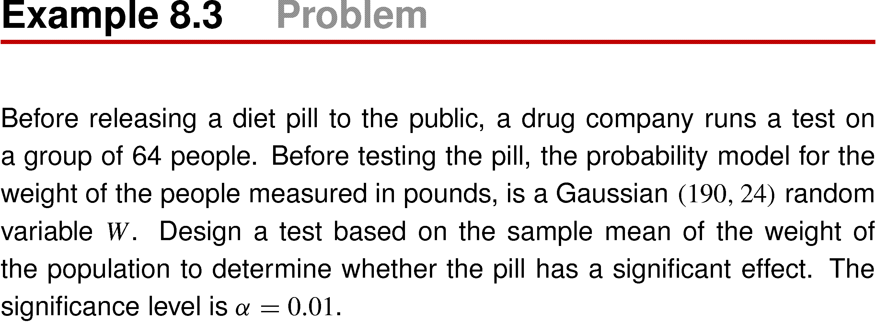
Example 8.3

Slide 15
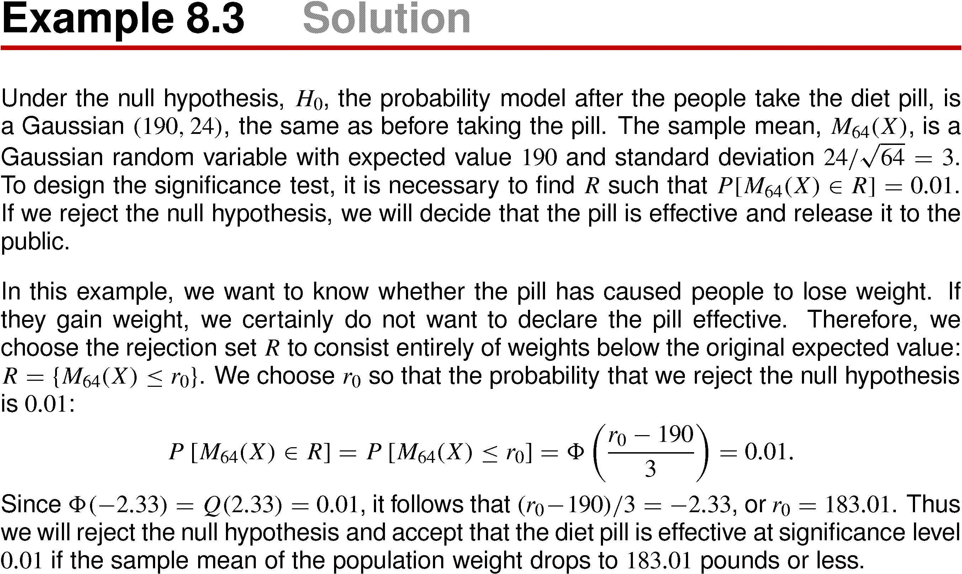
Example 8.3 Solution

Slide 16
Note the difference between the symmetrical reject set in Example 8.2 and the one-sided rejection set in Example 8.3, We selected these set on the basis of the application of the results of the test. In the language of statistical inference, the symmetrical set is part of a two-tail significance test, and the one-sided rejection set is part of a one-tail significance test.

Slide 17
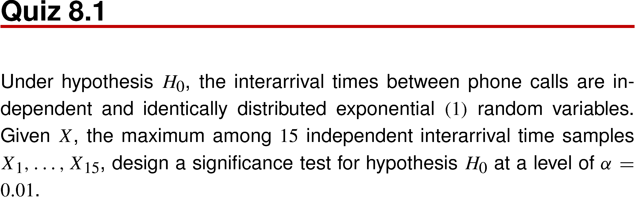
Quiz 8.1

Slide 18
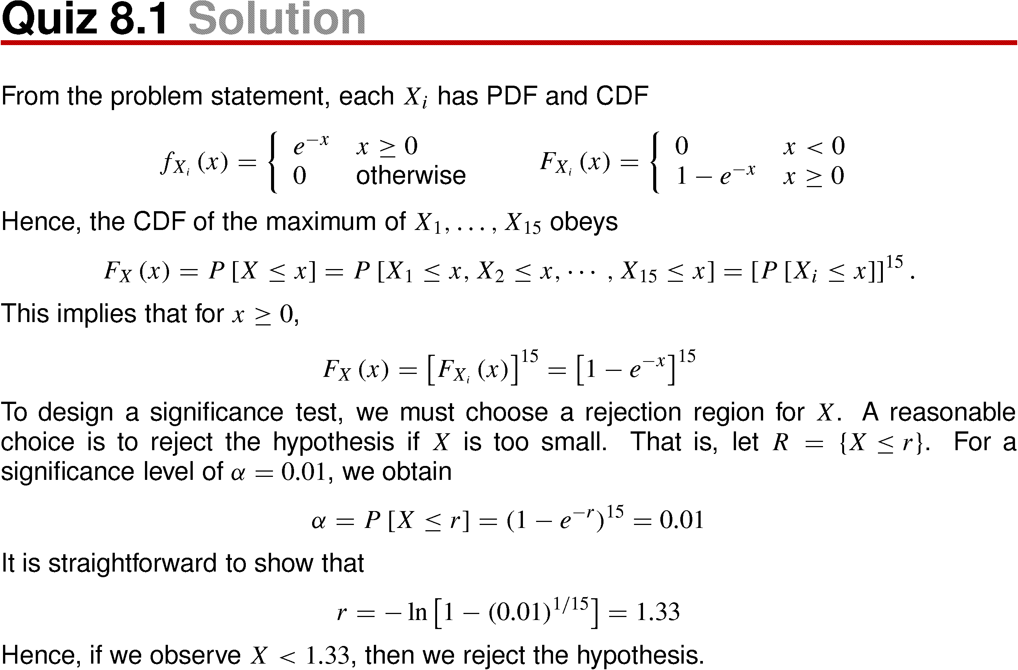
Quiz 8.1 Solution

Slide 19
8.2 Binary Hypothesis Testing

Slide 20
In a binary hypothesis test, there are two hypothetical probability models, H₀ and H₁, and two possible conclusions: accept H₀ as the true model , and accept H₁.
There is also a probability model for H₀ and H₁, conveyed by the numbers P[H₀] and P[H₁] = 1 – P[H₀]. These numbers are referred to as the a priori probabilities or prior probabilities of H₀ and H₁.
They reflect the state of knowledge about the probability model before an outcome is observed.

Slide 21
The complete experiment for a binary hypothesis test consists of two subexperiments.
The first subexperiment chooses a probability model from sample space S = {H₀, H₁}. The probability models H₀ and H₁ have the same space, S.
The second subexperiment produces an observation corresponding to an outcome, s ∈ S. When the observation leads to a random vector X, we call X the decision statistic. Often, the decision statistic is simply a random variable X.

Slide 22
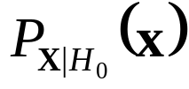
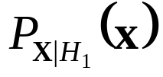
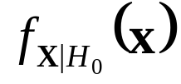
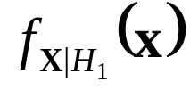
When the decision statistic X is discrete, the probability models are conditional probability mass function
and .
When X is continuous, the probability models are conditional probability density function and .
In the terminology of statistical inference, theses functions are referred to as likelihood function. For example,
is the likelihood of x given H₀.

Slide 23
The test design divides S into two sets, A₀ and A₁ = A₀^{C}. If the outcomes s ∈ A₀, the conclusion is accept H₀. Otherwise, the conclusion is accept H₁.
  The accuracy measure of the test consists of two error probabilities.
  P[A₁|H₀] is the probability of accepting H₁ when H₀ is the true probability model. It corresponds to the probability of a Type I error.
  P[A₀|H₁] is the probability of accepting H₀ when H₁ is the true probability model. It corresponds to the probability of a Type II error.
 | Null Hypothesis (H0) is true | Alternative Hypothesis (H1) is true
Fail to Reject Null Hypothesis (A0) | Right decision | Wrong decision Type II Error, P[A0|H1] False Negative
Reject Null Hypothesis (A1) | Wrong decision Type I Error, P[A1|H0] False Positive | Right decision

Slide 24
Electrical engineering application: radar system
Electrical engineering application: radar system
  Transmitter sends out a signal, and receiver decides whether a target is present.
  H₀: corresponds to the situation in which there is no target.
  H₁: corresponds to the presence of a target.
  Type I error (conclude target present when there is no target) is referred to as a false alarm.
  Type II error (conclude no target when there is a target present) is referred to as a miss.

Slide 25
Trade-off of binary hypothesis test
The design of a binary hypothesis test represents a trade-off between the two error probabilities P_{FA} = P[A₁|H₀] and P_{MISS} = P[A₀|H₁].
To understand the trade-off, consider two extreme designs:
A₀ = S and A₁ = φ ➔ P_{FA} = 0 and P_{MISS} = 1.
A₀ = φ and A₁ = S ➔ P_{FA} = 1 and P_{MISS} = 0.
A graph representing the possible value of P_{FA} and P_{MISS} is referred to as a receiver operating curve (ROC). Figure 8.1.

Slide 26
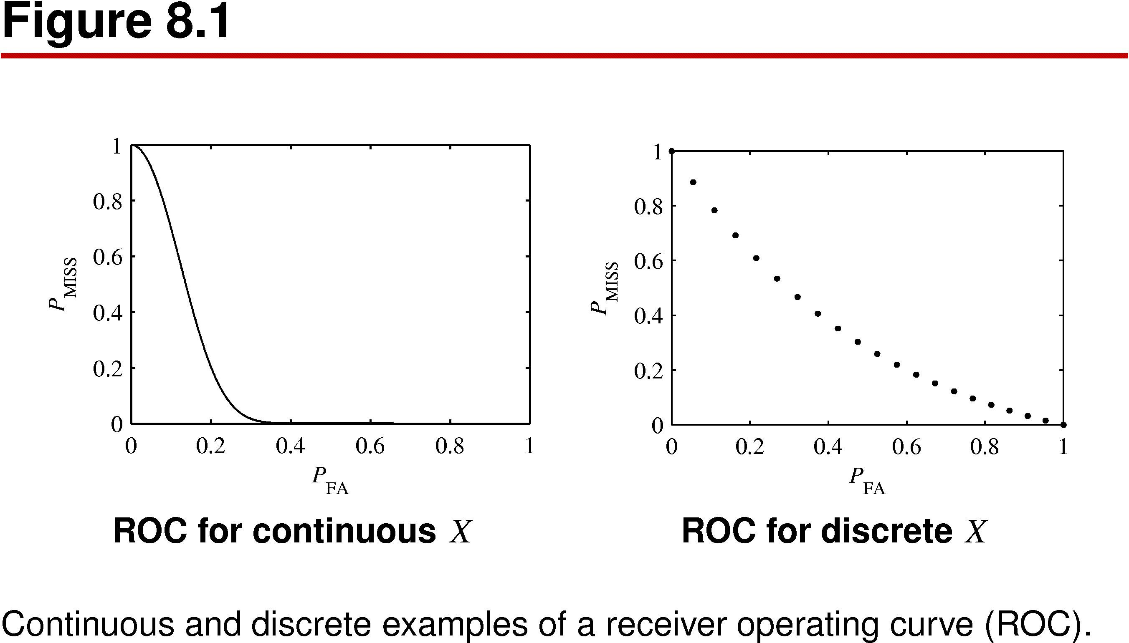
Figure 8.1

Slide 27
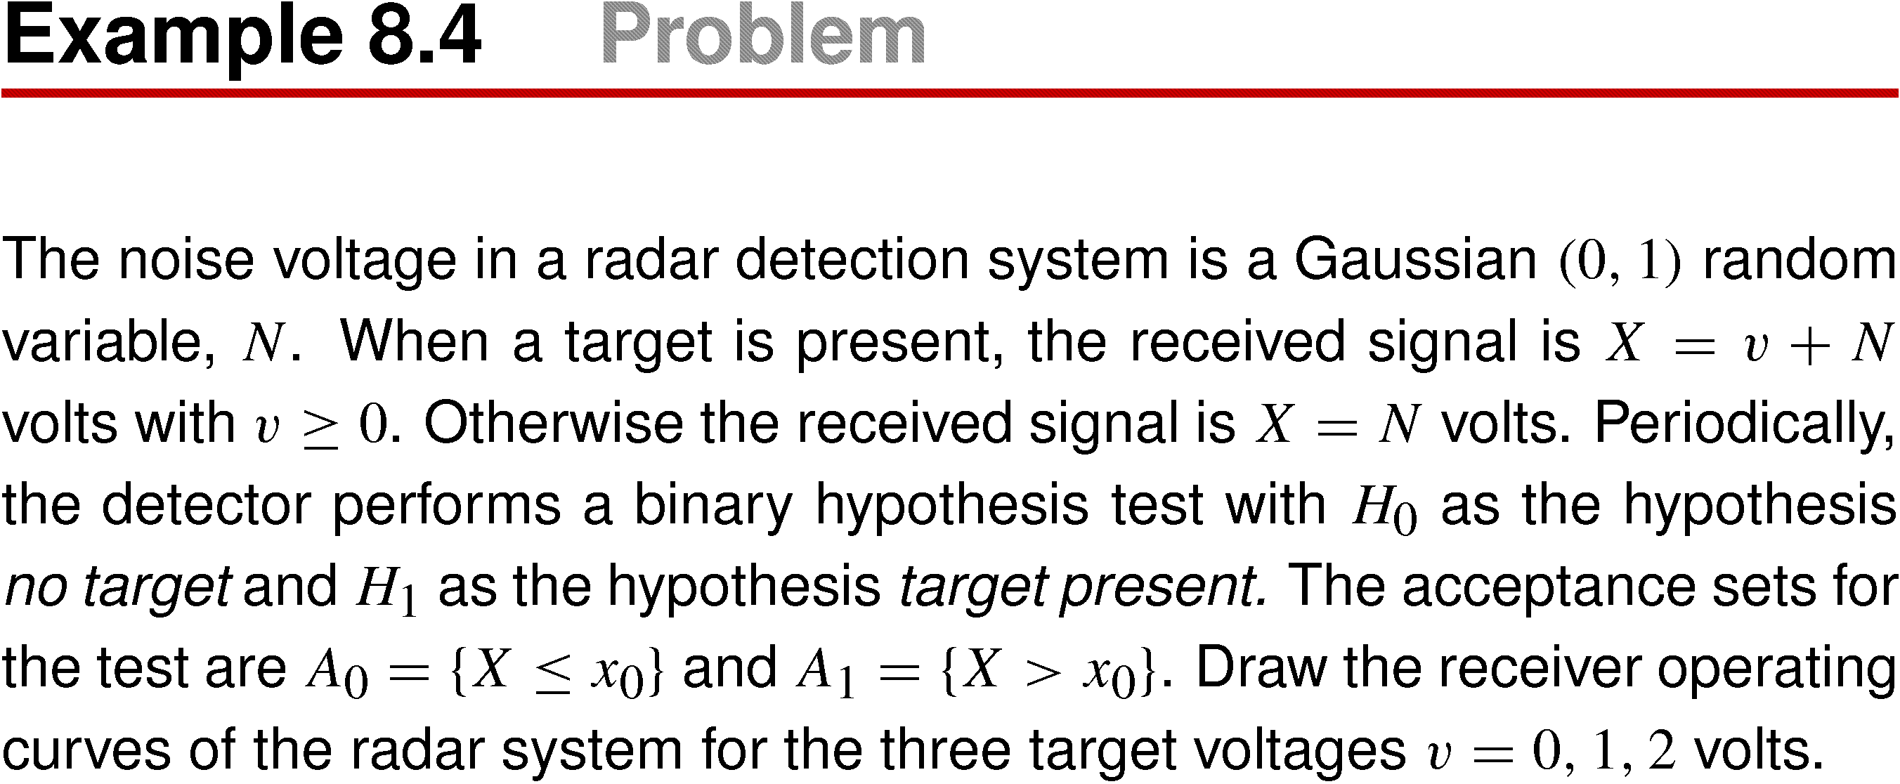
Example 8.4

Slide 28
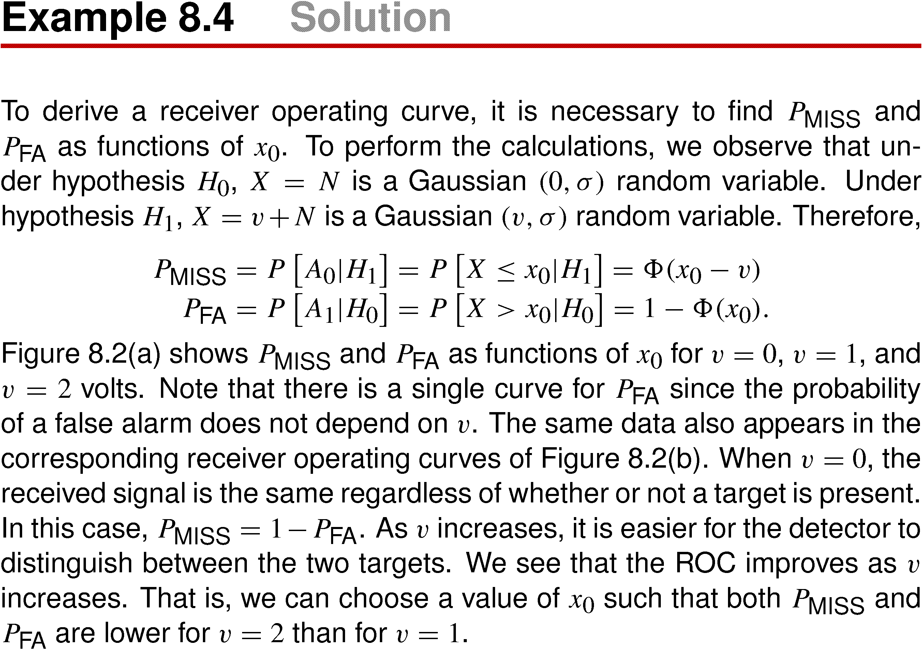
Example 8.4 Solution

Slide 29
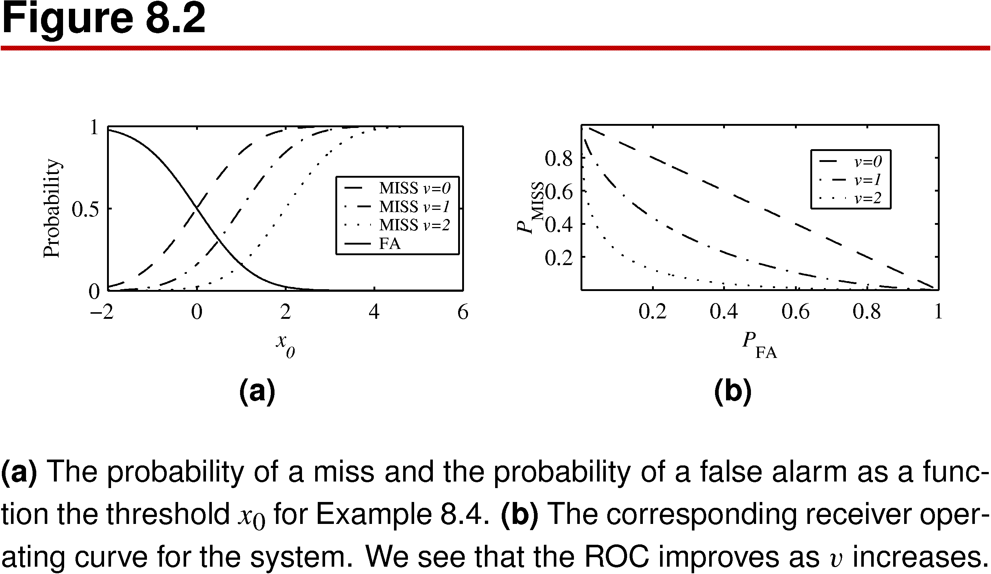
Figure 8.2

Slide 30
Trade-off between P_{FA} and P_{MISS}
In a practical binary hypothesis test, it is necessary to adopt one test (a specific A₀) and a corresponding trade-off between P_{FA} and P_{MISS}. There are many approaches to selecting A₀.
In the radar application, the cost of miss (ignoring a threatening target) could be far higher than the cost of a false alarm (causing the operator to take an unnecessary precaution).
This suggest that the radar system should operate with a low value of x₀ to produce a low P_{MISS} even though this will produce a relatively high P_{FA}.

Slide 31
The remainder of this section describes four methods of choosing A₀.
Maximum A posteriori Probability (MAP) test.
Minimum Cost Test
Neyman-Pearson Test
Maximum Likellihood Test.

Slide 32
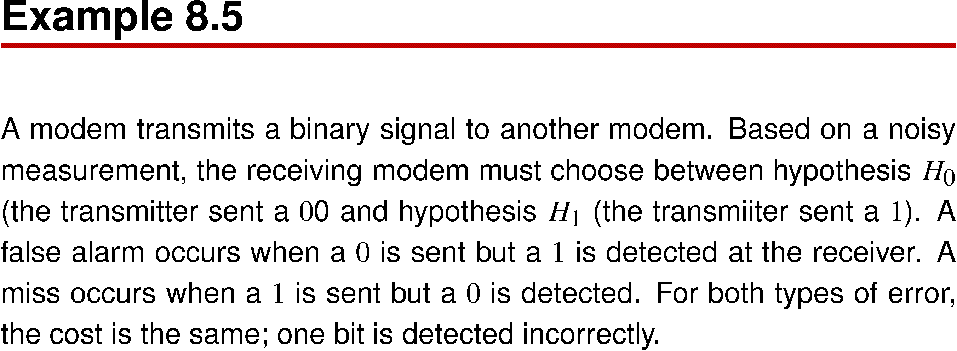
Example 8.5

Slide 33
Maximum A posteriori Probability (MAP) test
The maximum a posteriori probability test minimize P_{ERR}, the total probability of error of a binary hypothesis test. The law of total probability. Theorem 1.8, relates P_{MISS} to the a priori probabilities of H₀ and H₁ and to the two conditional error probabilities, P_{FA} = P[A₁|H₀] and P_{MISS} = P[A₀|H₁]:
P_{ERR} = P[A₁|H₀] P[H₀] + P[A₀|H₁] P[H₁]
When the two types of errors have the same cost as in Example 8.5, minimizing P_{ERR} is a sensible strategy. The following theorem specifies the binary hypothesis test that produces the minimum possible P_{ERR}.

Slide 34
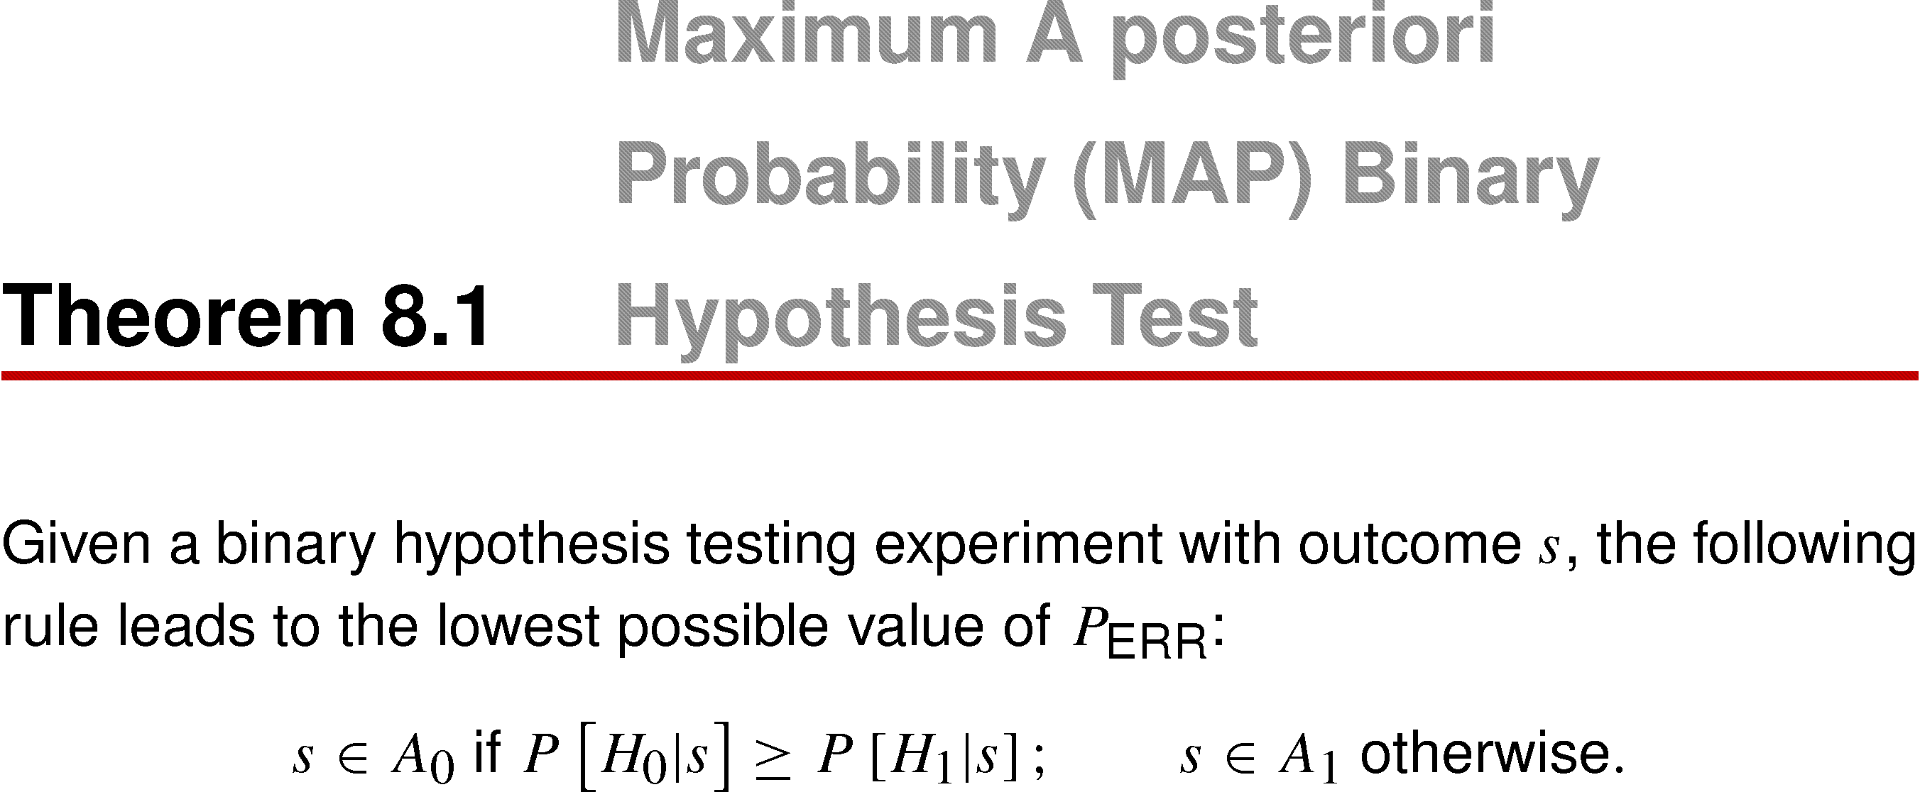
Theorem 8.1 Maximum A posteriori Probability (MAP) Binary Hypothesis Test

Slide 35
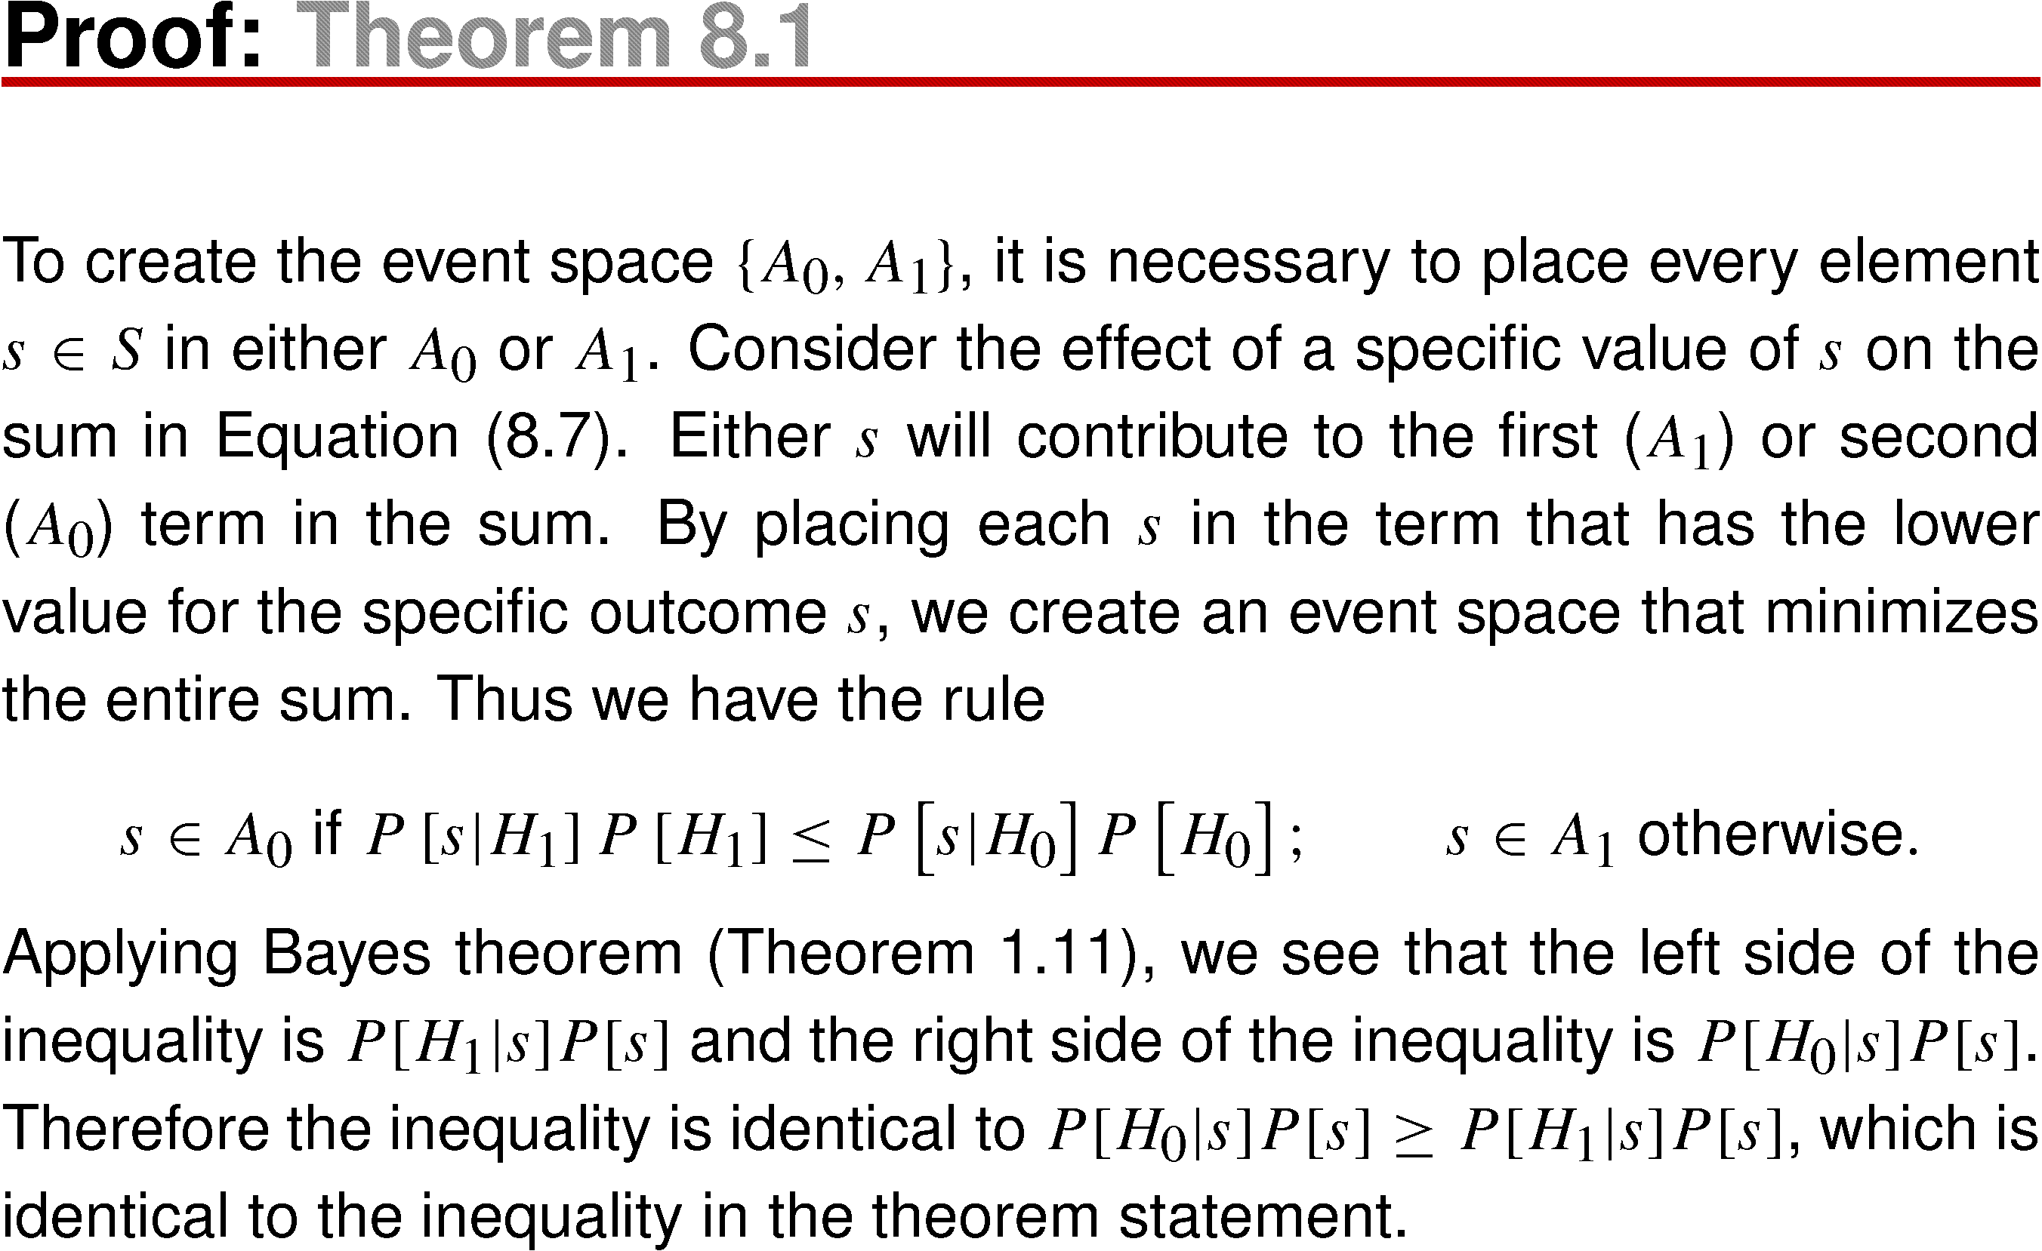
Theorem 8.1 Proof

Slide 36
Note that P[H₀|s] and P[H₁|s] are referred to as the a posteriori probabilities of H₀ and H₁. Just as the a priori probabilities P[H₀] and P[H₁] reflect out knowledge of H₀ and H₁ prior to performing an experiment, P[H₀|s] and P[H₁|s] reflect out knowledge after observing s.
Theorem 8.1 states that in order to minimize P_{ERR} it is necessary to accept the hypothesis with the higher a posteriori probability. A test that follows this rule is a maximum a posteriori probability (MAP) hypothesis test.
In such a test A₀ contains all outcomes s for which P[H₀|s] > P[H₁|s], and A₁ contains all outcomes s for which P[H₀|s] < P[H₁|s]. If P[H₀|s] = P[H₁|s] , the assignment of s to either A₀ or A₁ does not affect P_{ERR}.

Slide 37
In Theorem 8.1 we arbitrarily assign s to A₀ when the a posteriori probabilities are equal. We would have the same probability of error if we assign s to A₁ for all outcomes that produce equal a posteriori probabilities or if we assign some outcomes with equal a posteriori probabilities to A₀ and others to A₁.
Equation in proof is another statement of the MAP decision rule. It contains the three probability models that are assumed to be known:
  The a priori probability of the hypotheses: P[H₀] and P[H₁].
  The likelihood function of H₀: P[s|H₀].
  The likelihood function of H₁: P[s|H₁].

Slide 38
When the outcomes of an experiment yield a random vector X as the decision statistic, we can express the MAP rule in terms of conditional PMFs and PDFs.
If X is discrete, we can take X = x_{i} to be the outcome of the experiment.
If the sample space S of the experiment is continuous, we interpret the conditional probabilities by assuming that each outcome corresponds to the random vector X in the small volume x ≤ X < x + dx with probability f_{X}(x)dx. Section 4.9 demonstrates that the conditional probabilities are ratios of probability densities. Thus in terms of the random variable X, we have the following version of the MAP hypothesis test.

Slide 39
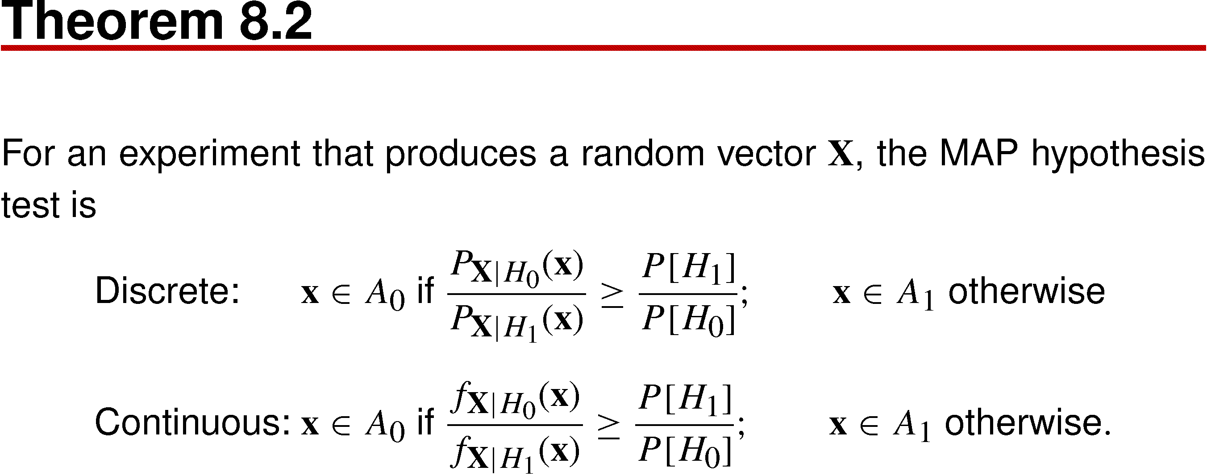
Theorem 8.2
Likelihood ratio
(based on experiments)
Ratio of prior probability
(prior to experiment)

Slide 40
In these formulas, the ratio of conditional probabilities is referred to as a likelihood ratio. The formulas state that in order to perform a binary hypothesis test, we observe the outcome of an experiment, calculate the likelihood ratio on the left side of the formula, and compare it with a constant on the right side of the formula.
We can view the likelihood ratio as the evidence, based on an observation, in favor of H₀. If the likelihood ratio is grater than 1, H₀ is more likely than H₁. The ratio of prior probabilities, on the right side, is the evidence, prior to performing the experiment, in favor of H₁. Therefore, Theorem 8.2 states that H₀ is the better conclusion if the evidence in favor of H₀, based on the experiment, outweighs the prior evidence in favor of H₁.
In many practical hypothesis tests, it is convenient to compare the logarithms of the two ratios.

Slide 41
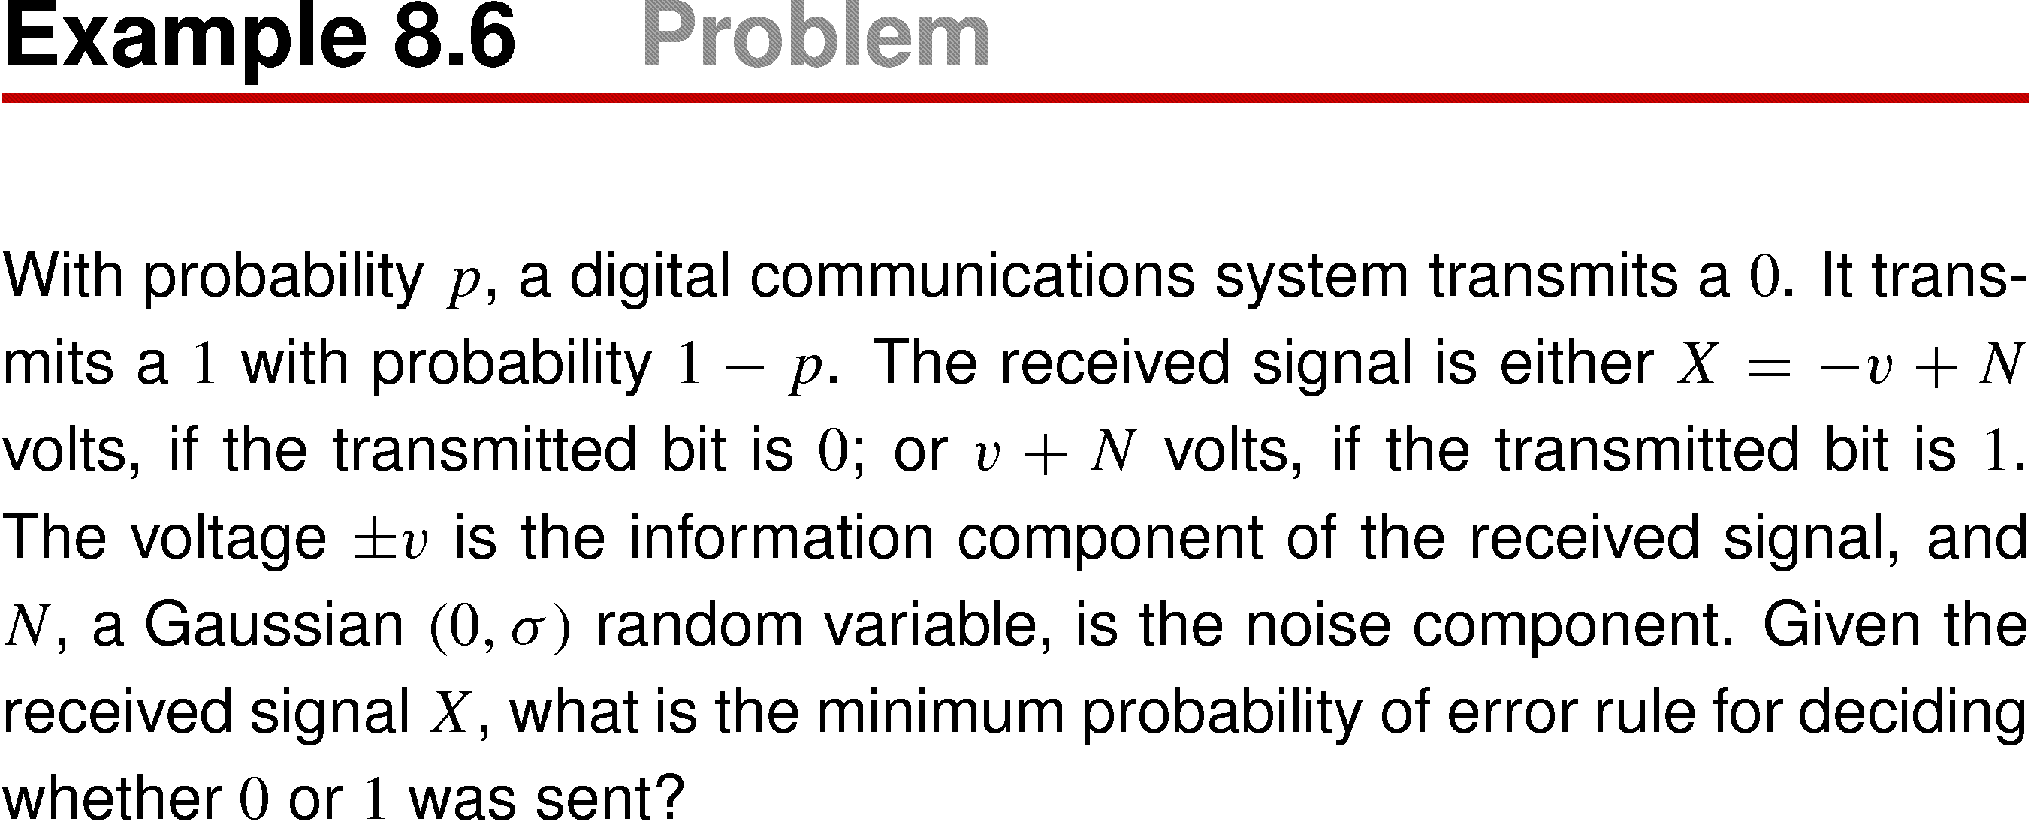
Example 8.6

Slide 42
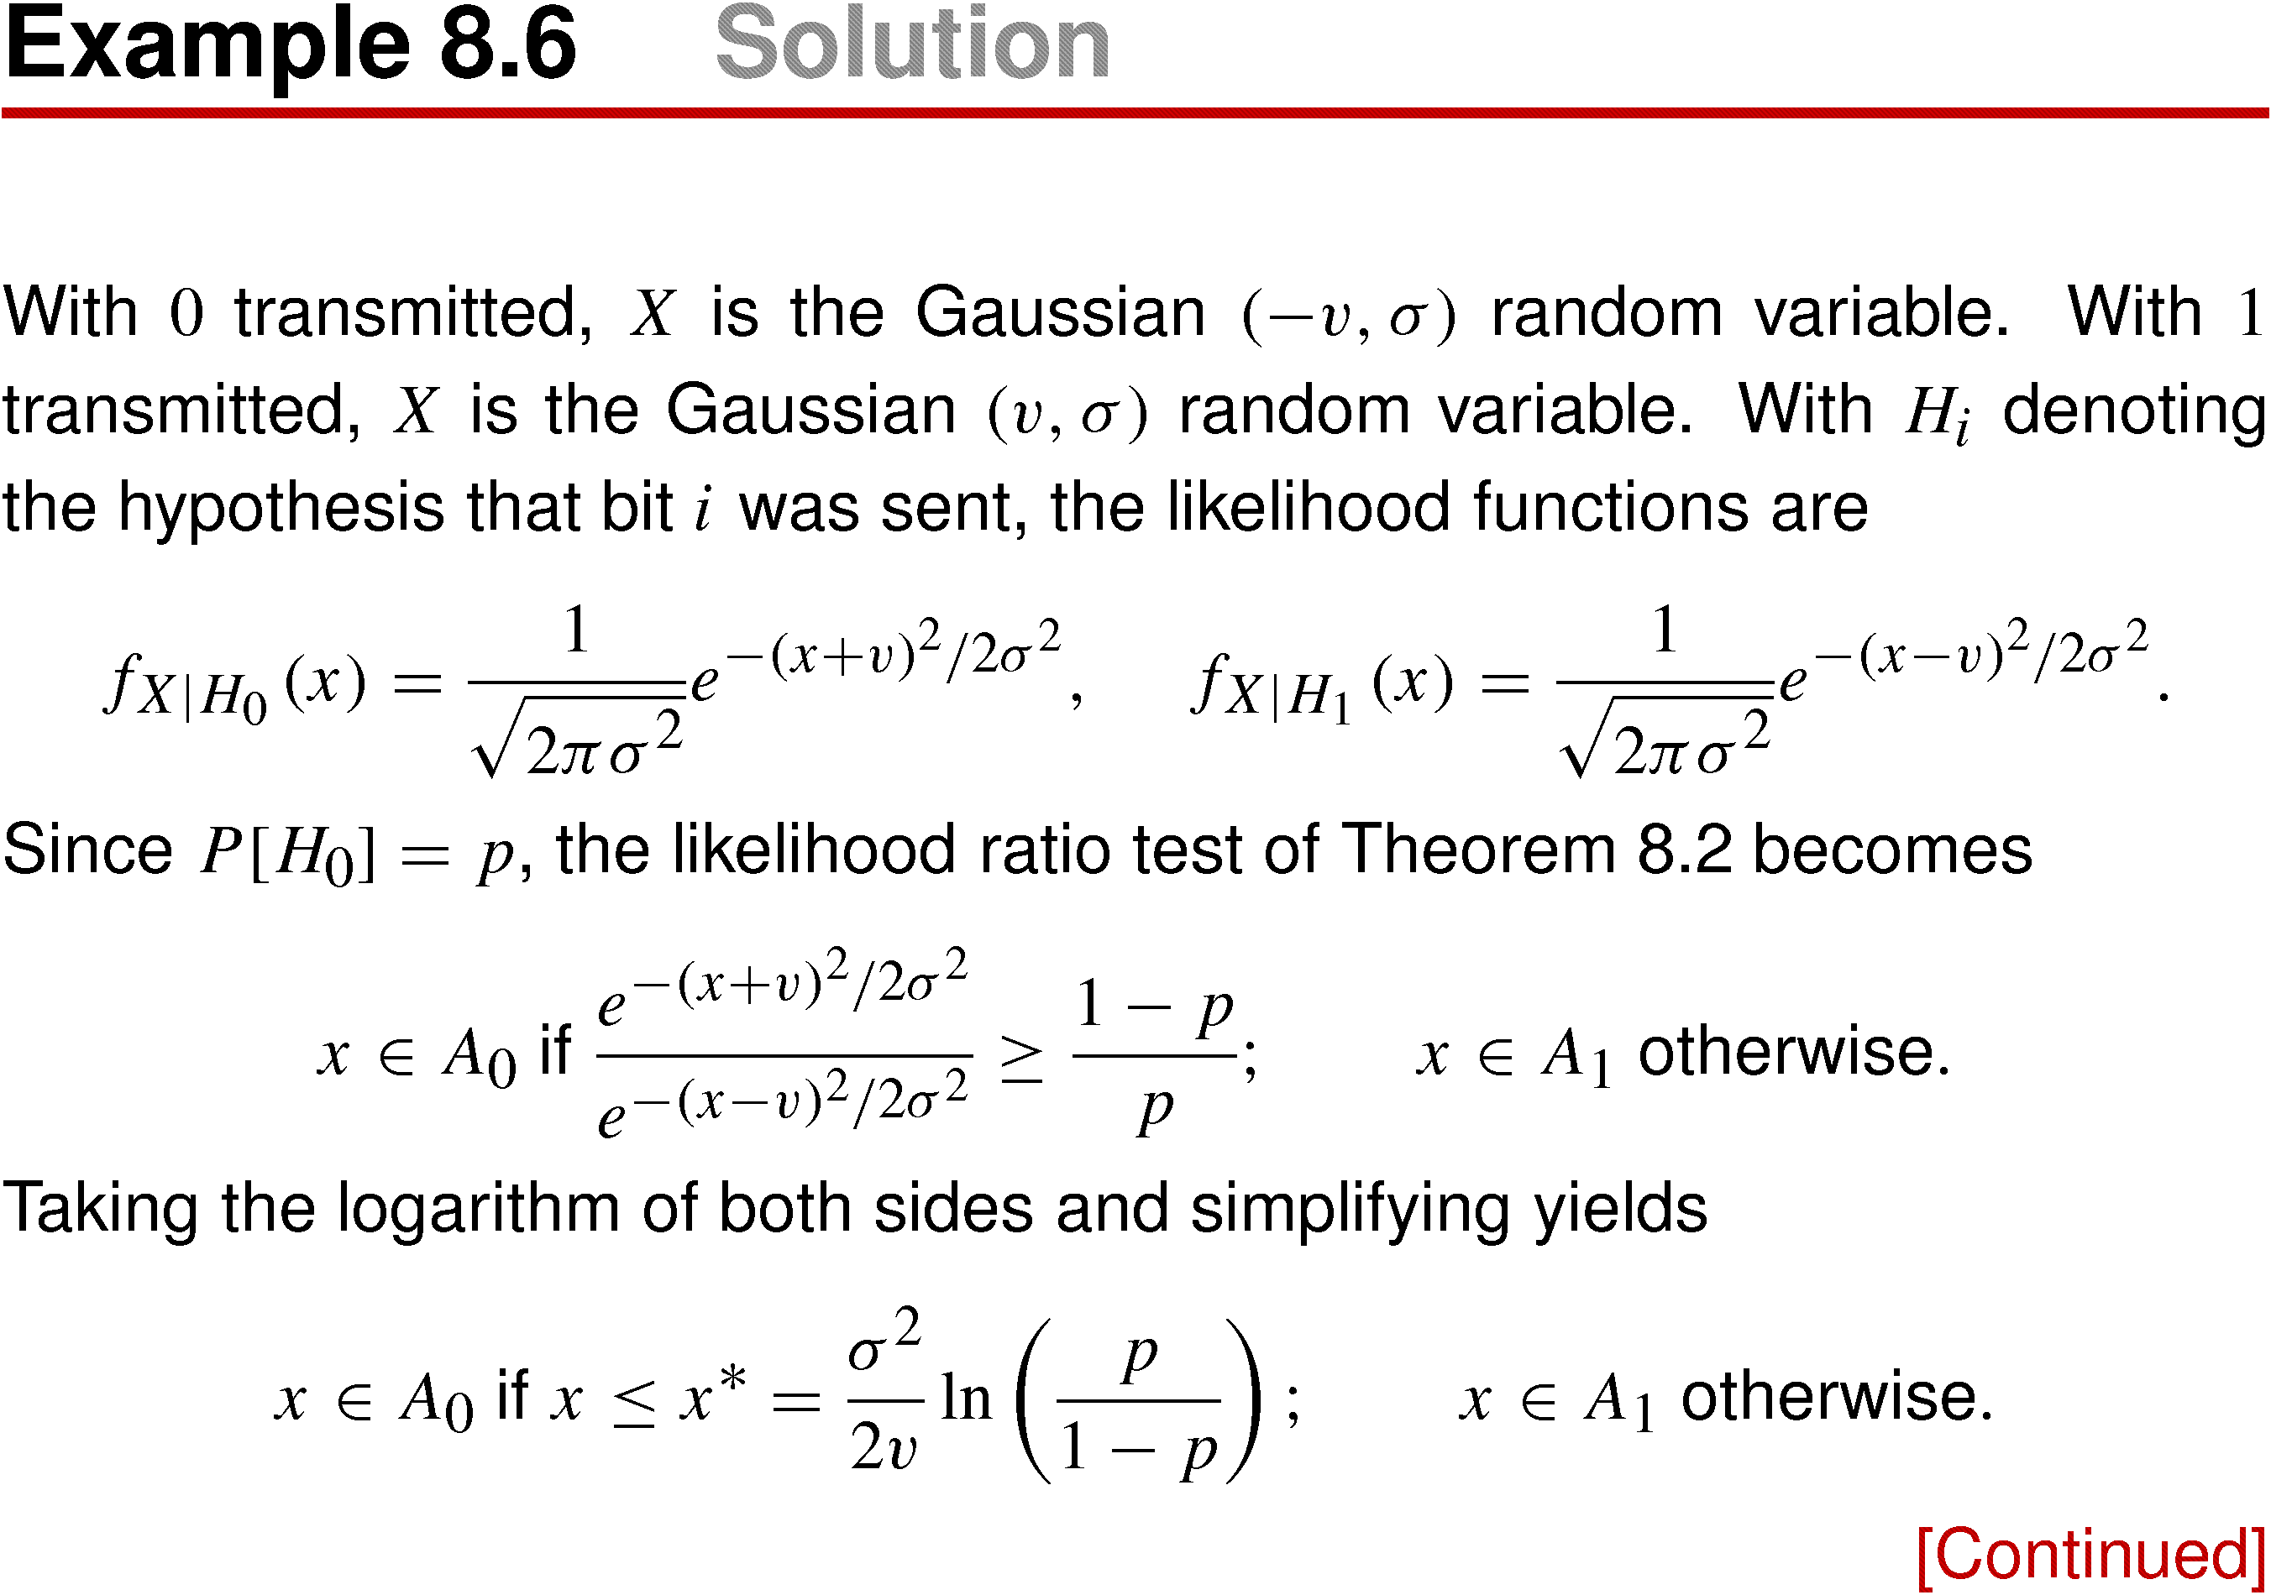
Example 8.6 Solution

Slide 43
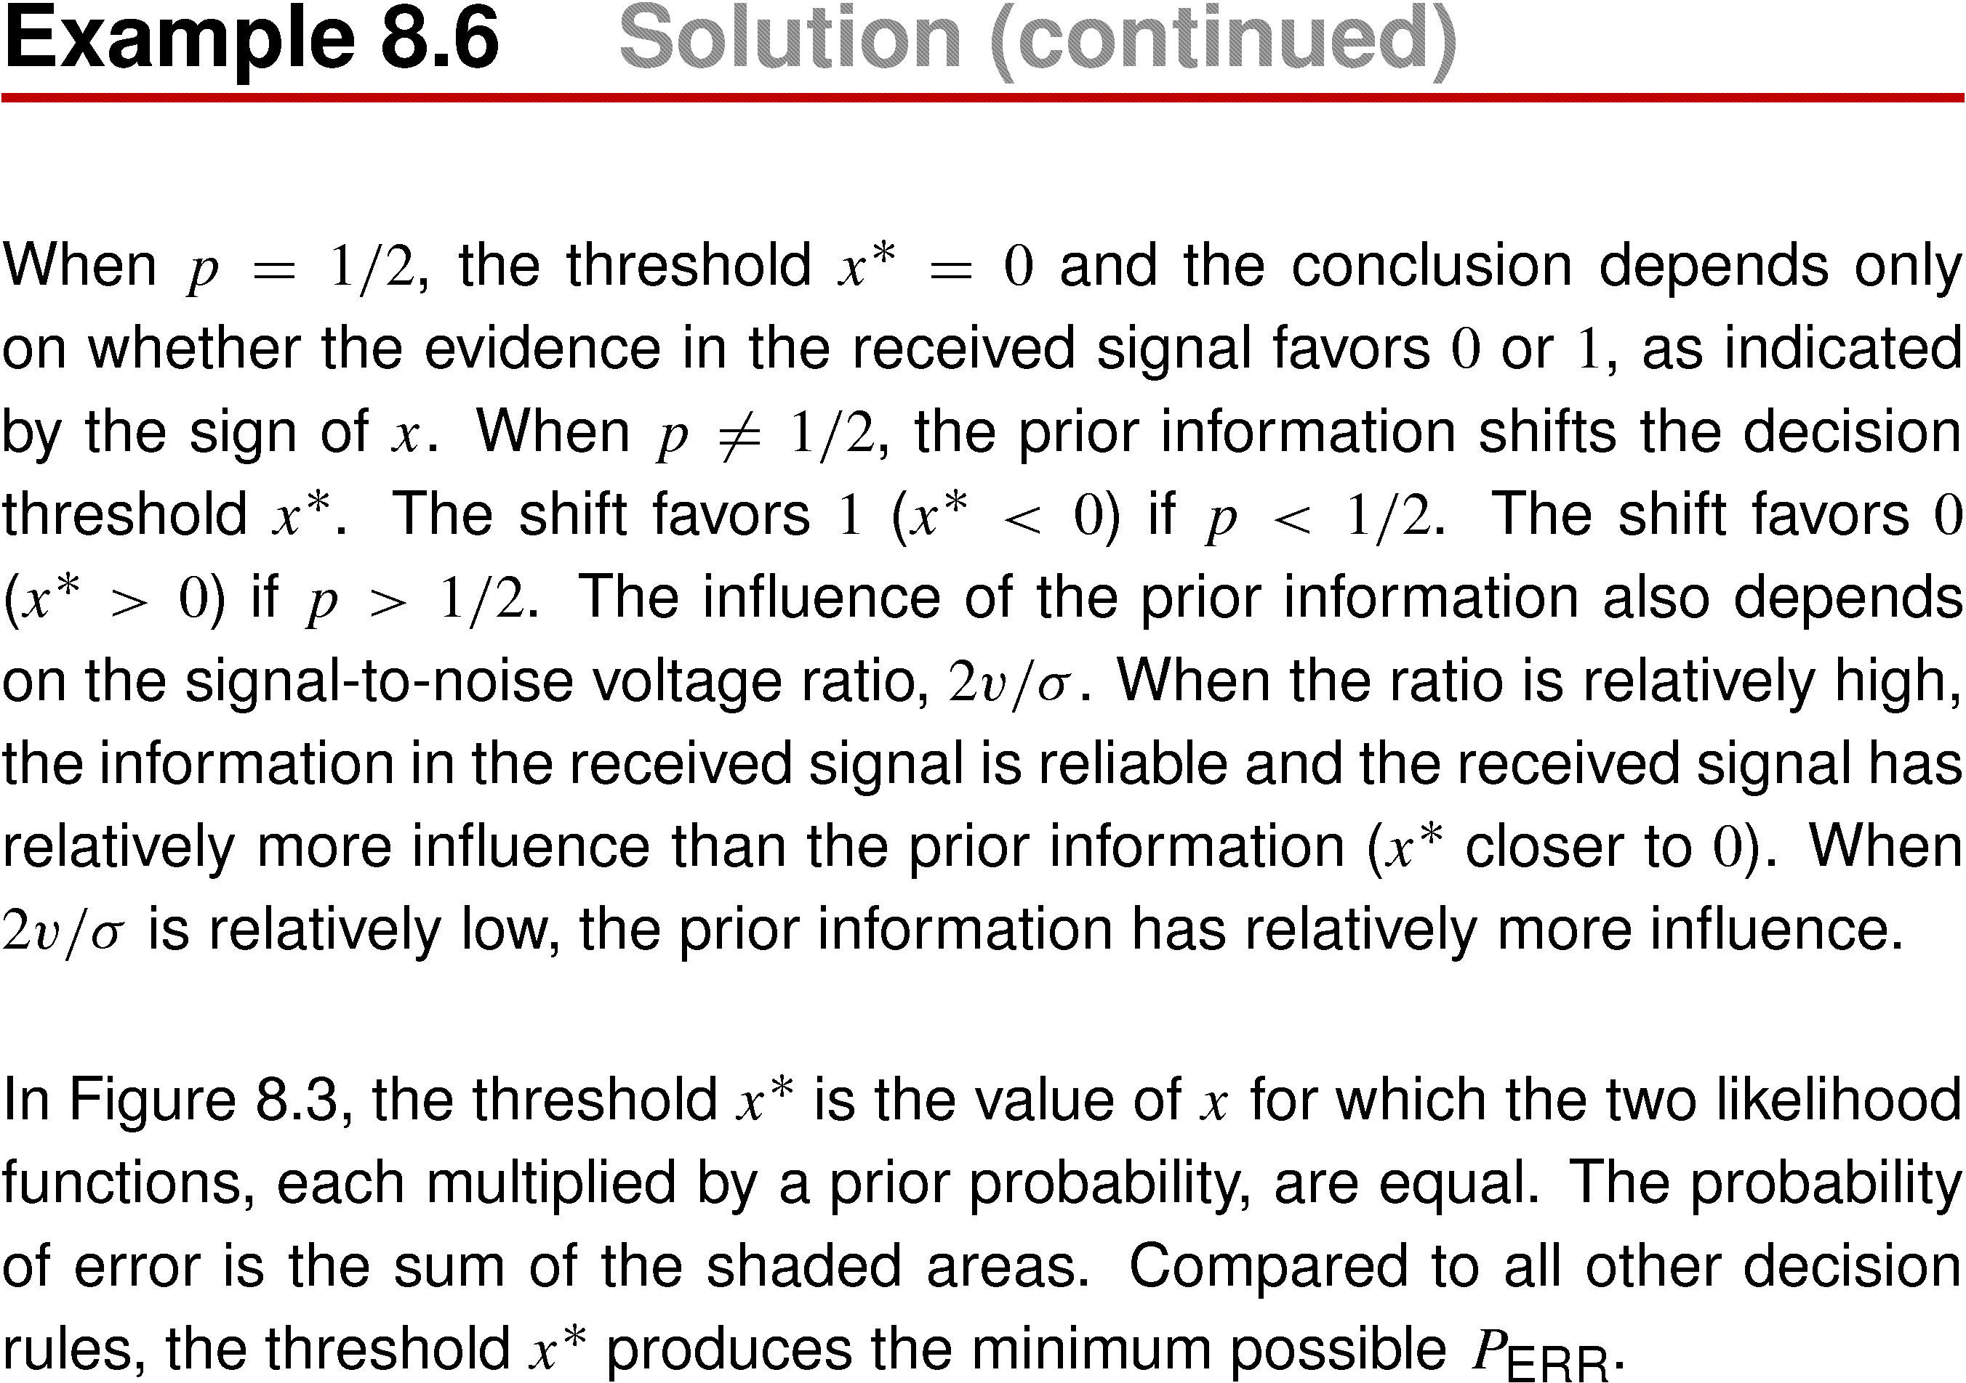
Example 8.6 Solution (continued)

Slide 44
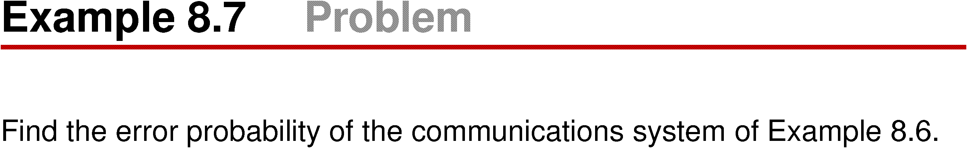
Example 8.7

Slide 45
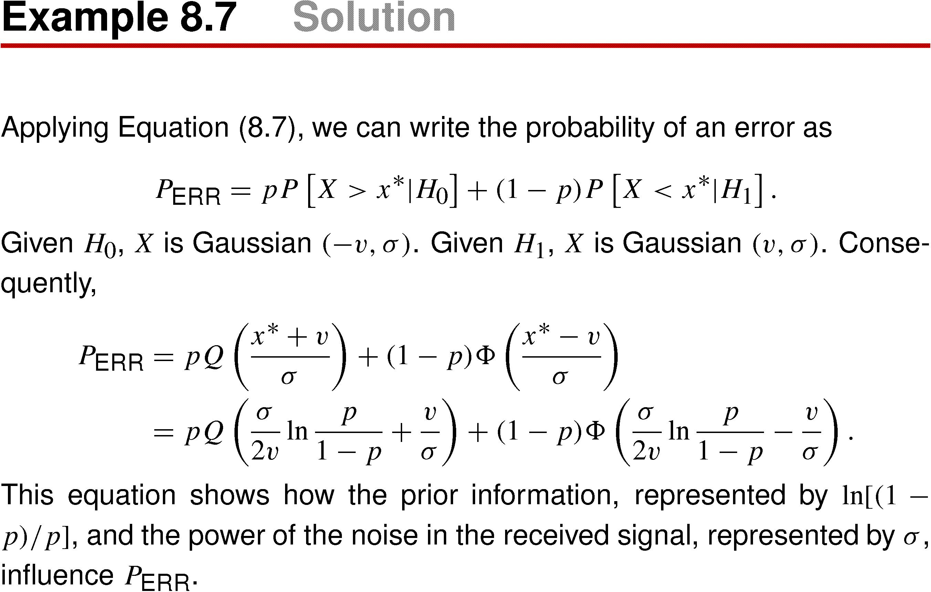
Example 8.7 Solution

Slide 46
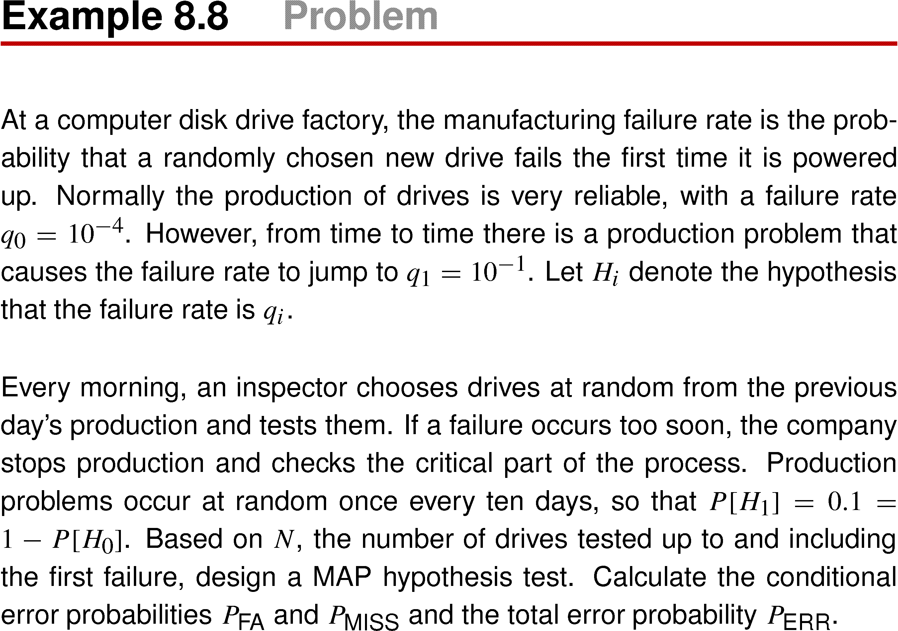
Example 8.8

Slide 47
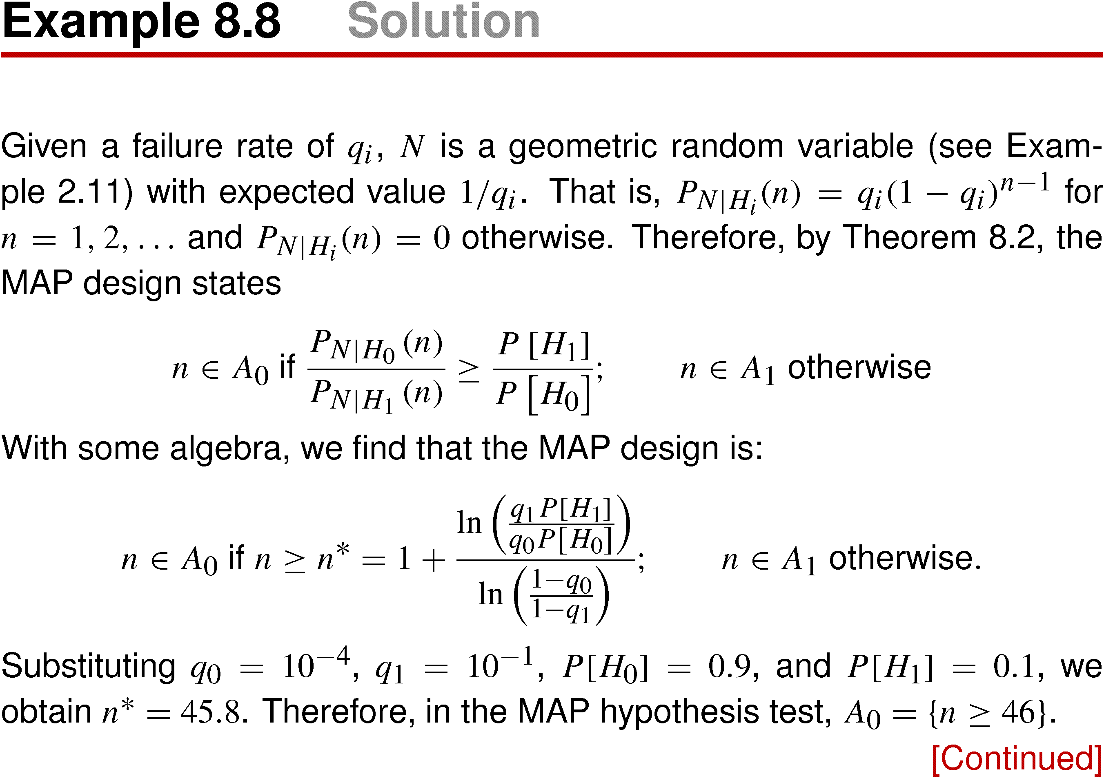
Example 8.8 Solution

Slide 48
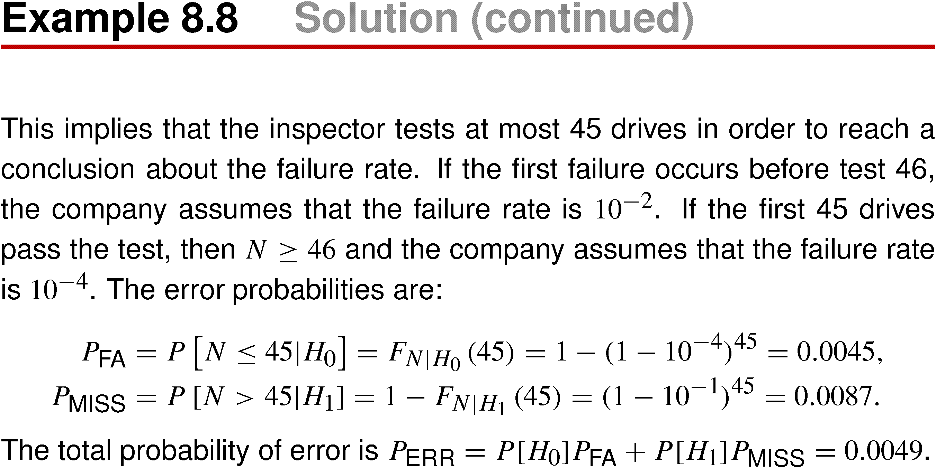
Example 8.8 Solution (continued)

Slide 49
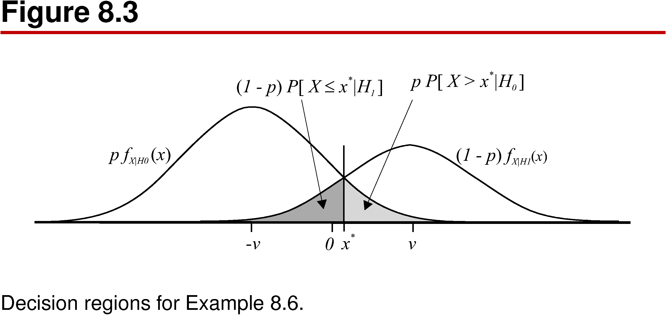
Figure 8.3

Slide 50
Minimum Cost Test
The MAP test implicitly assume that both types of errors (miss and false alarm) are equally serious. As discussed in connection with the radar application earlier in this section, this is not the case in many important situations. Consider application in which C = C₁₀ units is the cost of a false alarm (decide H₁ when H₀ is correct) and C = C₀₁ units is the cost of a miss (decide H₀ when H₁ is correct). In this situation the expected cost of test errors is
E[C] = P[A₁|H₀] P[H₀] C₁₀+ P[A₀|H₁] P[H₁] C₀₁
Minimizing E[C] is the goal of the minim cost hypothesis test. When the decision statistic is a random vector X, we have the following theorem.

Slide 51
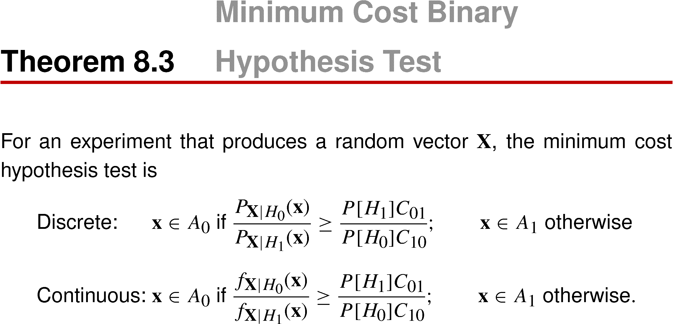
Theorem 8.3 Minimum Cost Binary Hypothesis Test

Slide 52
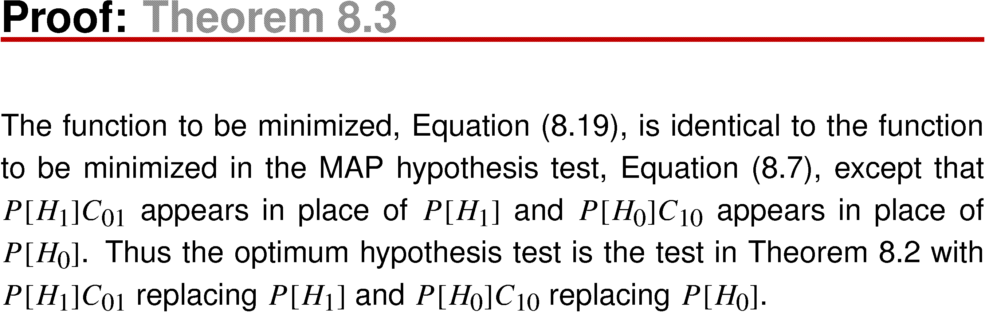
Theorem 8.3 Proof

Slide 53
In this test we note that only the relative cost C₀₁/C₁₀ influences that test, not the individual costs or the units in which cost is measured.
A ratio > 1 implies that misses are more costly than false alarms. Therefore, a ratio > 1 expands A₁, the acceptance set for H₁, make it harder to miss H₁ when it is correct.
On the other hand, the same ratio contacts H₀ and increases the false alarm probability, because a false alarm is less costly than a miss.

Slide 54
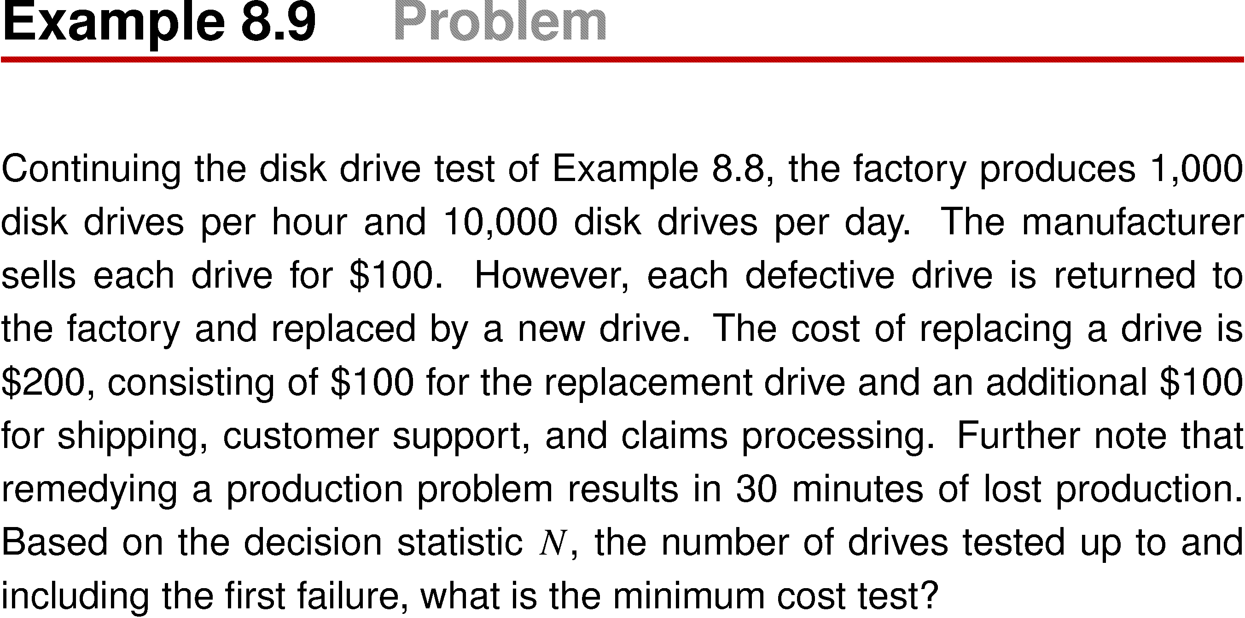
Example 8.9

Slide 55
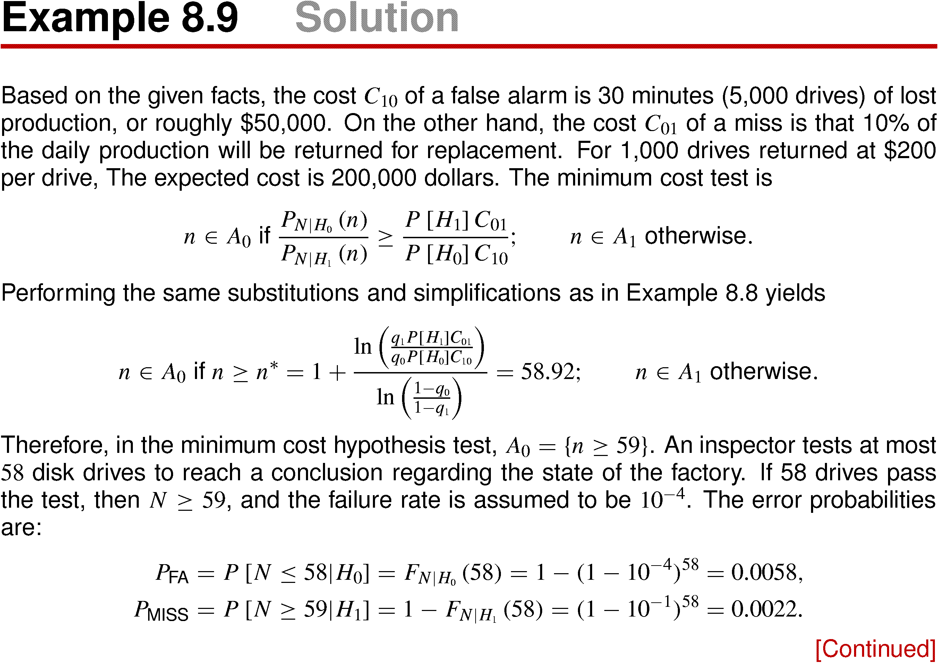
Example 8.9 Solution

Slide 56
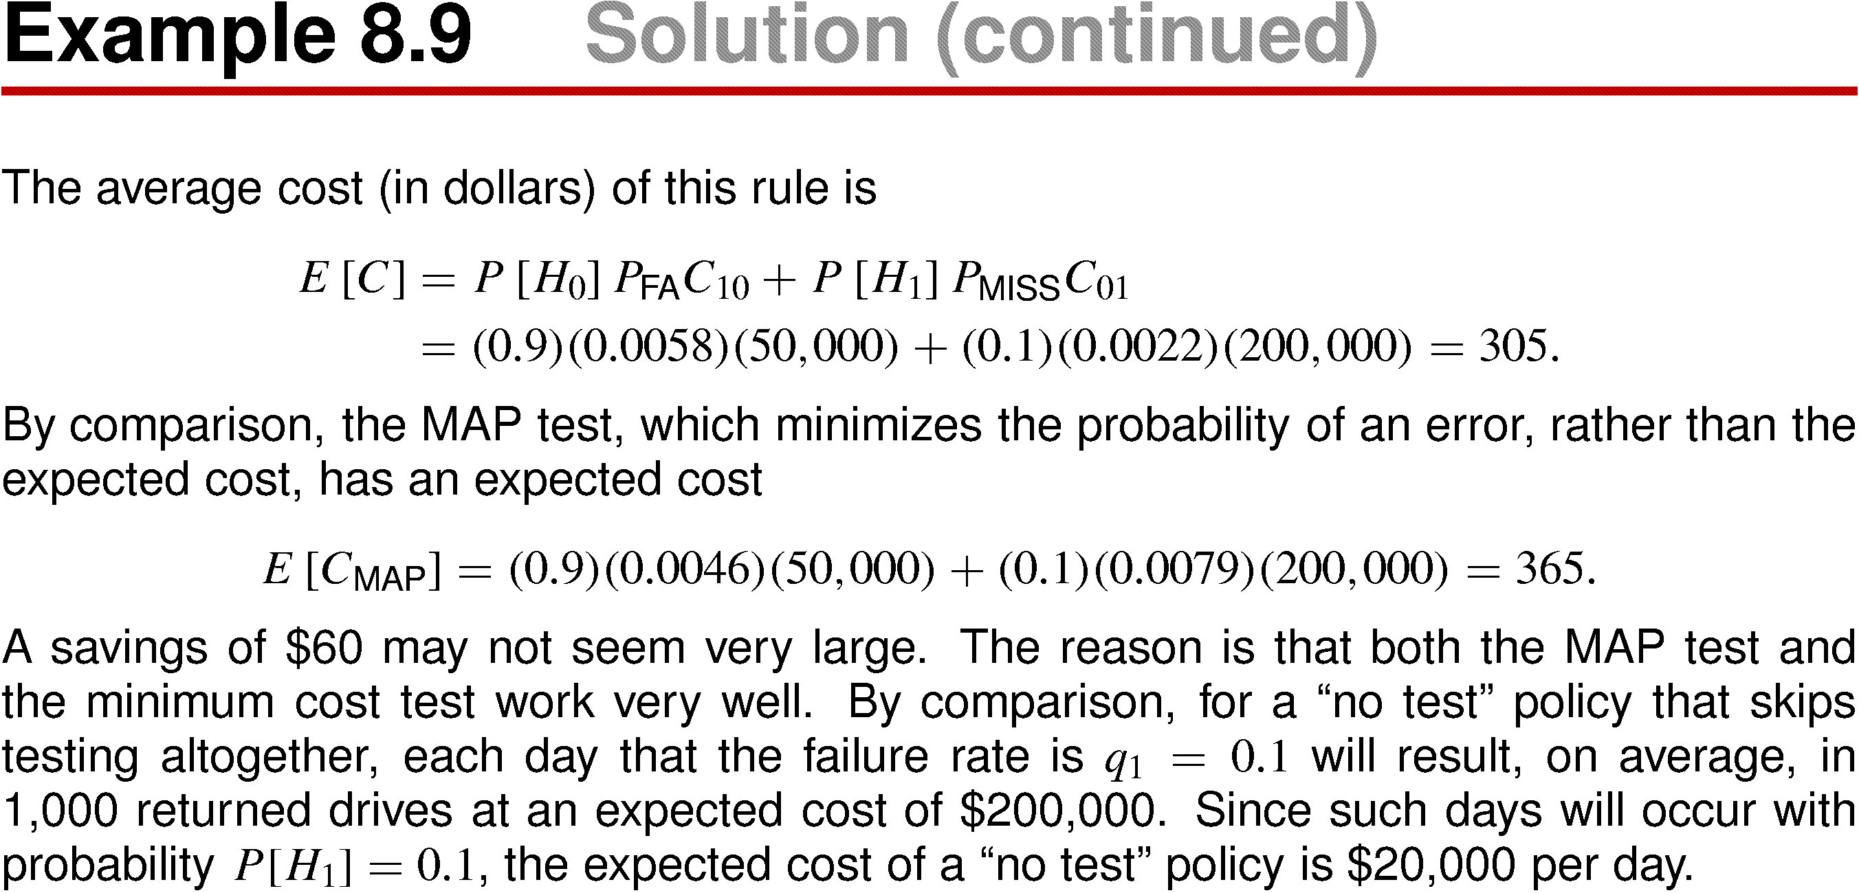
Example 8.9 Solution (continued)

Slide 57
Neyman-Pearson Test
Given an observation, the MAP test minimizes the probability of accepting the wrong hypothesis and minimum cost test minimizes the cost of errors.
However, the MAP test requires that we know the a priori probabilities P[H_{i}] of the competing hypotheses, and the minimum cost test required that we know in addition the relative costs of the two types of errors.
In many situations, these costs and a priori probabilities are difficult or even impossible to specify. In this case an alternate approach would be specify a tolerable level for either the false alarm or miss probability. This idea is the basis for the Neyman-Pearson test.

Slide 58
The Neyman-Pearson test minimizes P_{MISS} subject to the false alarm probability constraint P_{FA} = α, where α is a constant that indicates out tolerance of false alarm Because P_{FA} = P[A₁|H₀] and P_{MISS} = P[A₀|H₁] are conditional probabilities, the test does not require the a priori probabilities P[H₀] and P[H₁]. We first describe the Neyman-Pearson test when the decision statistic is a continuous random vector X.

Slide 59
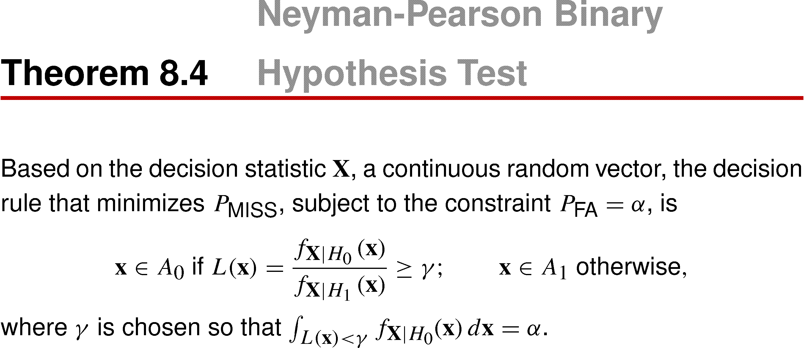
Theorem 8.4 Neyman-Pearson Binary Hypothesis Test

Slide 60
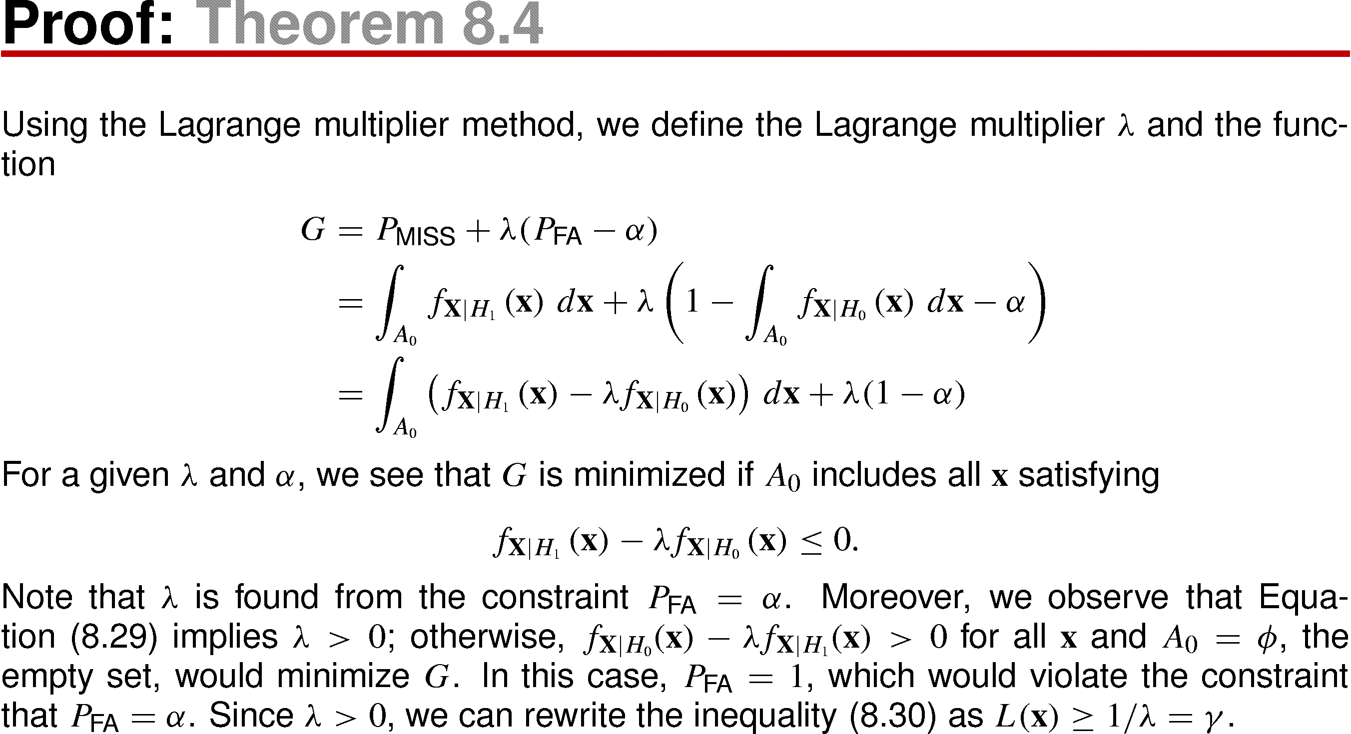
Theorem 8.4 Proof
(8.29)
(8.30)

Slide 61
In the radar system of Example 8.4, the decision statistic was a random variable X and the receiver operating curves (ROCs) of figure 8.2 were generated by adjusting a threshold x₀ that specified the sets A₀ = {X ≤ x₀} and A₁ = {X > x₀}. Example 8.4 did not question whether this rule finds the best ROC. For each specified value of P_{FA} = α, the Neyman-Pearson test identifies the decision rule that minimizes P_{MISS} .
In the Neyman-Pearson test, an increase in γ decreases P_{MISS} but increase P_{FA}. When the decision statistic X is a continuous random vector, we can choose γ so that false alarm probability is exactly α. This may not be possible when X is discrete, In discrete case, we have the following version of the Neyman-Pearson test.

Slide 62
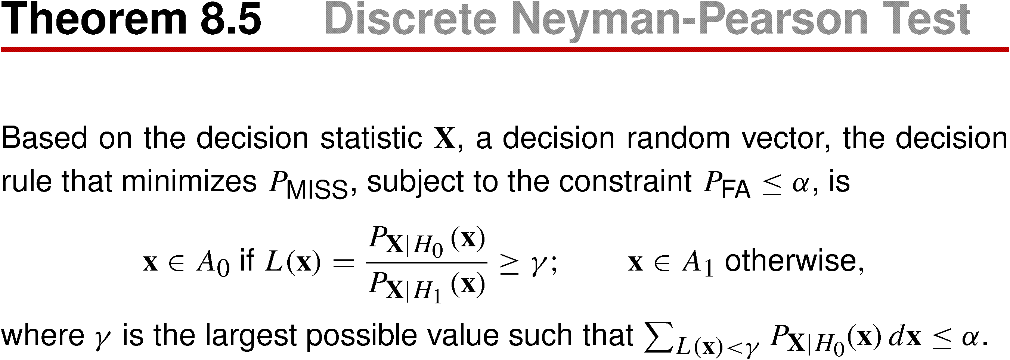
Theorem Discrete Neyman-Pearson Test

Slide 63
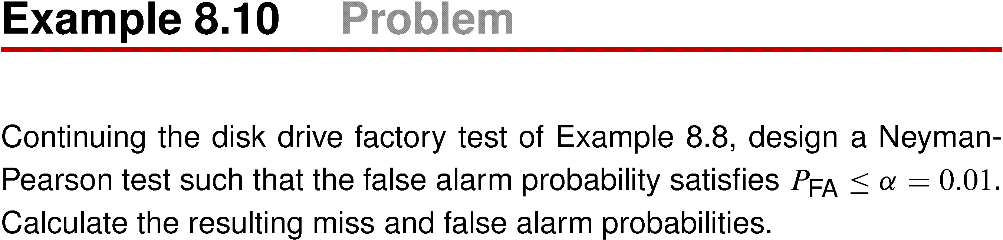
Example 8.10

Slide 64
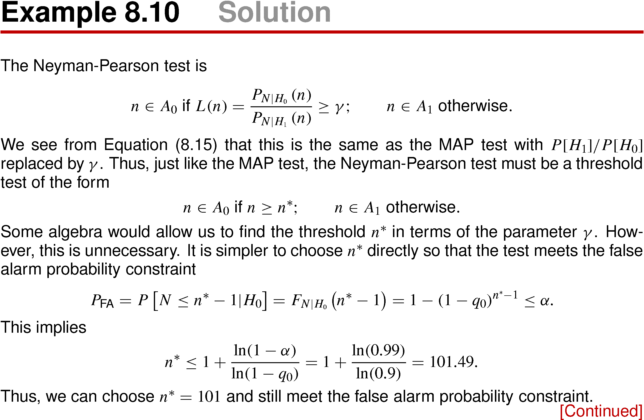
Example 8.10 Solution

Slide 65
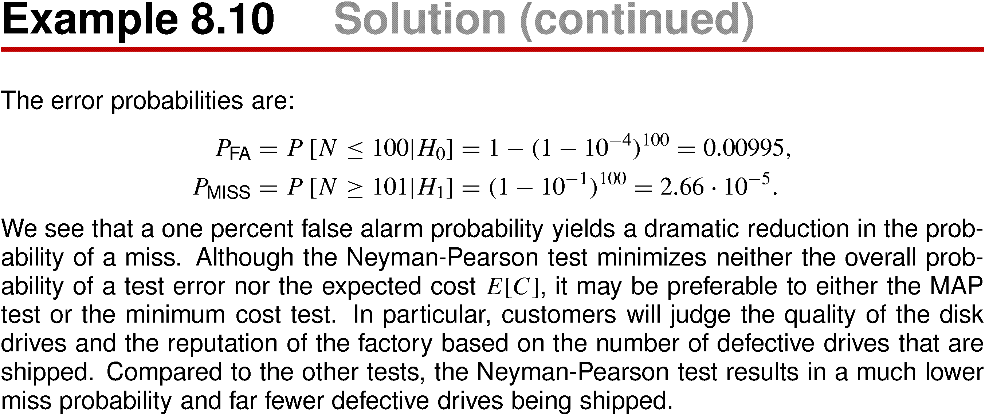
Example 8.10 Solution (continued)

Slide 66
Maximum Likelihood Test
Similar to the Neyman-Pearson test, the maximum likelihood (ML) test is another method that avoids the need for a priori probabilities.
Under the ML approach, we treat the hypothesis as some sort of “unknown” and choose a hypothesis H_{i} for which P[s|H_{i}], the conditional probability of the outcome s given the hypothesis H_{i} is largest. The idea behind choosing hypothesis to maximize the probability of the observation is to avoid making assumptions about the a priori probabilities P[H_{i}]. The resulting decision rule, called maximum likelihood (ML) rule, can be written mathematically as:

Slide 67
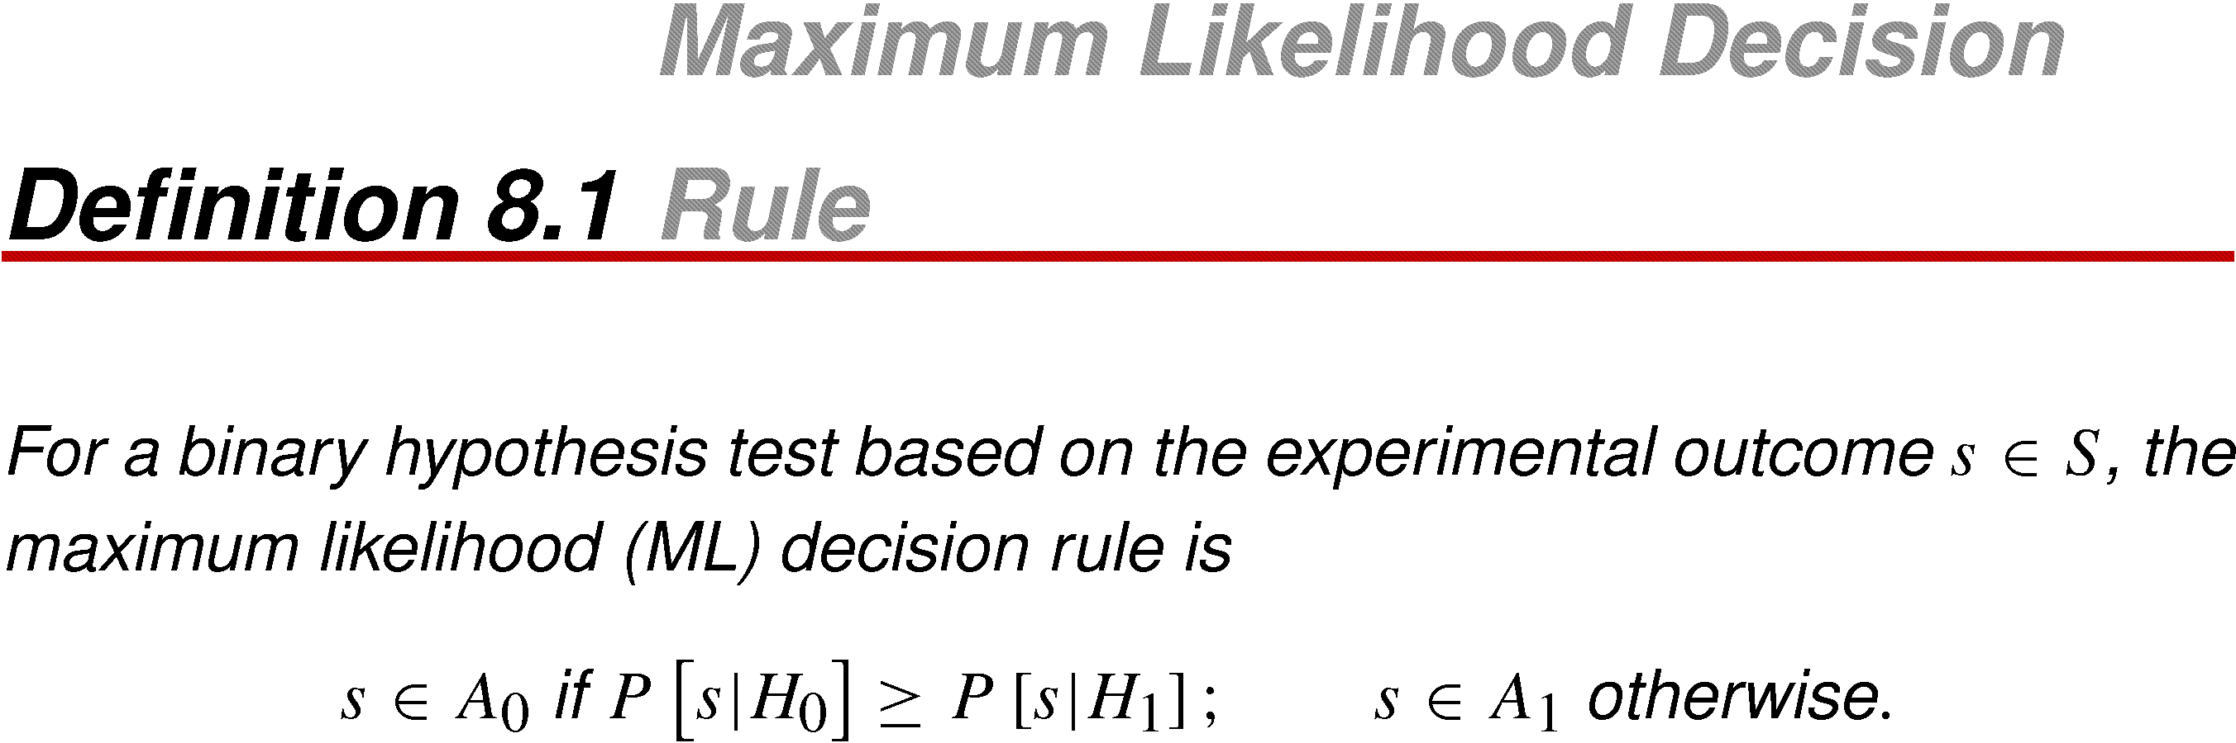
Definition 8.1 Maximum Likelihood Decision Rule

Slide 68
Comparison Theorem 8.1 and Definition 8.1, we see that in the absence of information about the a priori probabilities P[H_{i}], we have adopted a maximum likelihood decision rule that is the same as the MAP rule under the assumption that hypotheses H₀ and H₁ occur with equal probability. In essence, in the absence of a priori information, the ML rule assumes that all hypotheses are equally likely. By comparing the likelihood ratio to a threshold equal to 1, the ML hypothesis test is neutral about whether H₀ has a higher probability than H₁ or vice versa.
When the decision statistic of the experiment is a random vector X, we can express the ML rule in terms of conditional PMFs or PDFs, just as we did for the MAP rule.

Slide 69
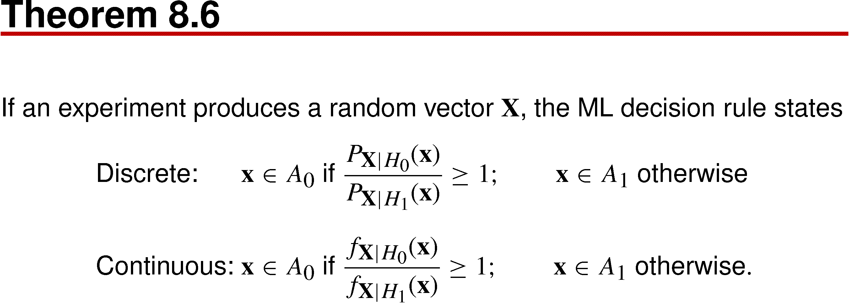
Theorem 8.6

Slide 70
Comparing Theorem 8.6 to Theorem 8.4, when X is continuous, or Theorem 8.5, when X is discrete, we see that the maximum likelihood test is the same as the Neyman-Pearson test with parameter γ = 1. This guarantees that the maximum likelihood test is optimal in the limited sense that no other test can reduce P_{MISS} for the same P_{FA}.
In practice, we use a ML hypothesis test in many applications. It is almost as effective as the MAP hypothesis test when the experiment that produces outcomes s is reliable in the sense that P_{ERR} for the ML test is low. To see why this is true, examine the decision rule in Example 8.6. When the signal-to-noise ratio 2v/σ is high, the threshold (of the log-likelihood ratio) is close to 0, which means that the result of the MAP hypothesis test is close to the result of a ML hypothesis test, regardless of the prior probability p.

Slide 71
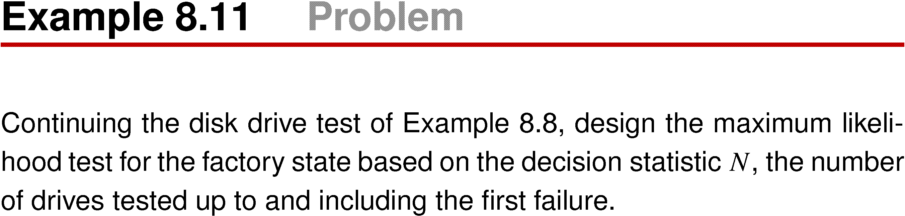
Example 8.11

Slide 72
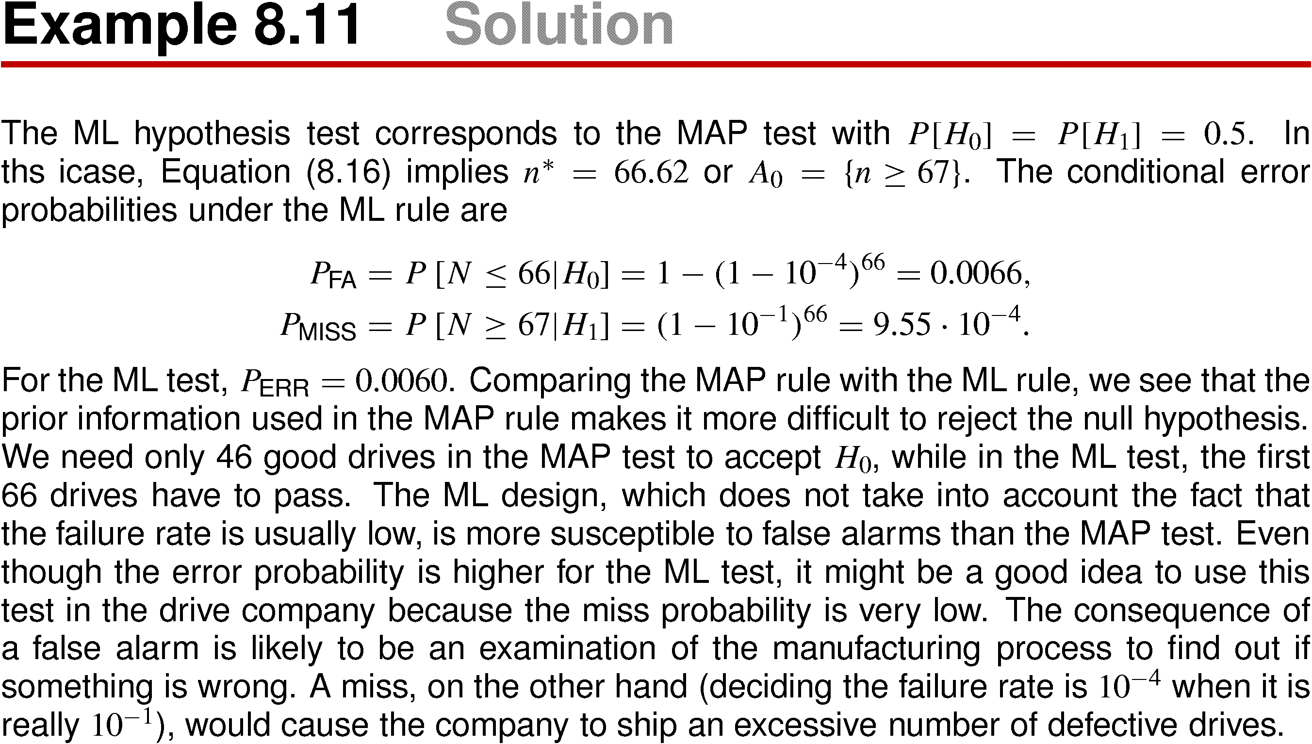
Example 8.11 Solution

Slide 73
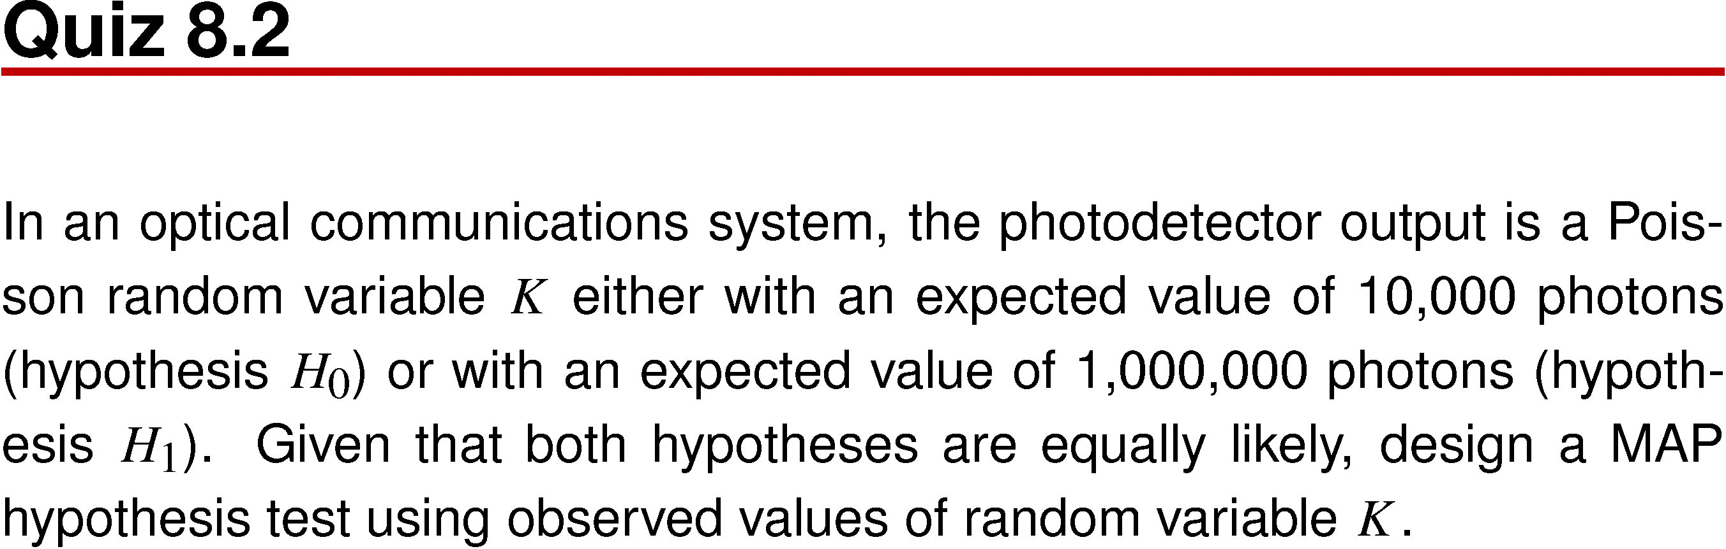
Quiz 8.2

Slide 74
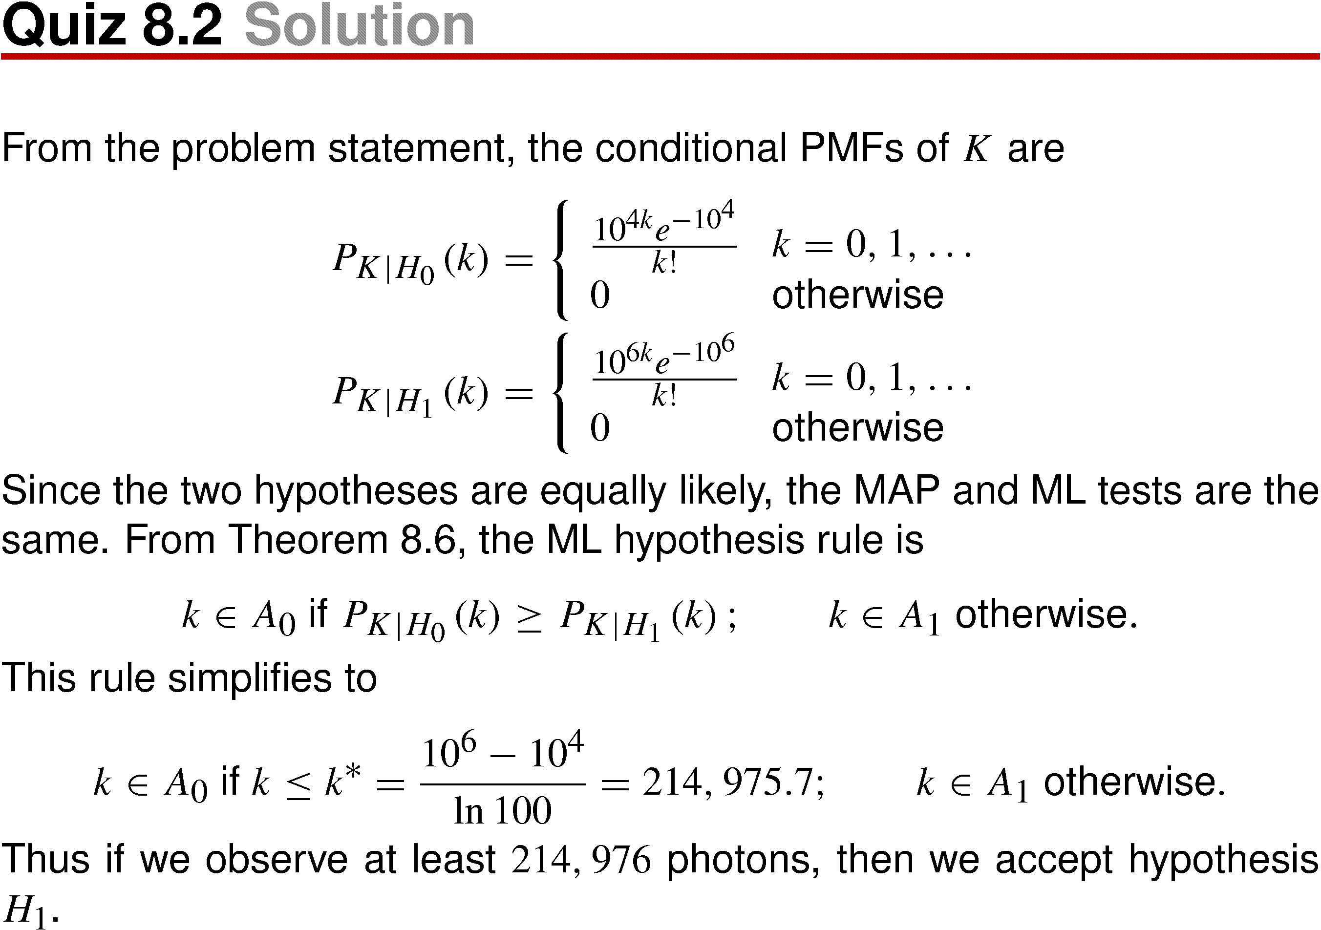
Quiz 8.2 Solution

Slide 75
8.3 Multiple Hypothesis Test

Slide 76
There are many application in which an experiment can conform to more than two known probability models, all with the same sample space S. A multiple hypothesis test is a generalization of a binary hypothesis test.
There are M hypothetical probability models: H₀, H₁, …, H_{M – 1}. We perform an experiment and based on the outcome, we come to the conclusion that a certain H_{m} is the true probability model.
The design of the experiment consists of dividing S into an event space consisting of mutually exclusive, collectively exhaustive sets, A₀, A₁, …, A_{M – 1}, such tat the conclusion is accept H_{i} if s ∈ A_{i}, The accuracy measure of the experiment consists of M² conditional probabilities, P[A_{i}|H_{j}], i, j = 0, 1, 2, …, M – 1. The M probabilities, P[A_{i}|H_{i}], i = 0, 1, 2, …, M – 1 are probabilities of correct decisions. The remaining probabilities are error probabilities.

Slide 77
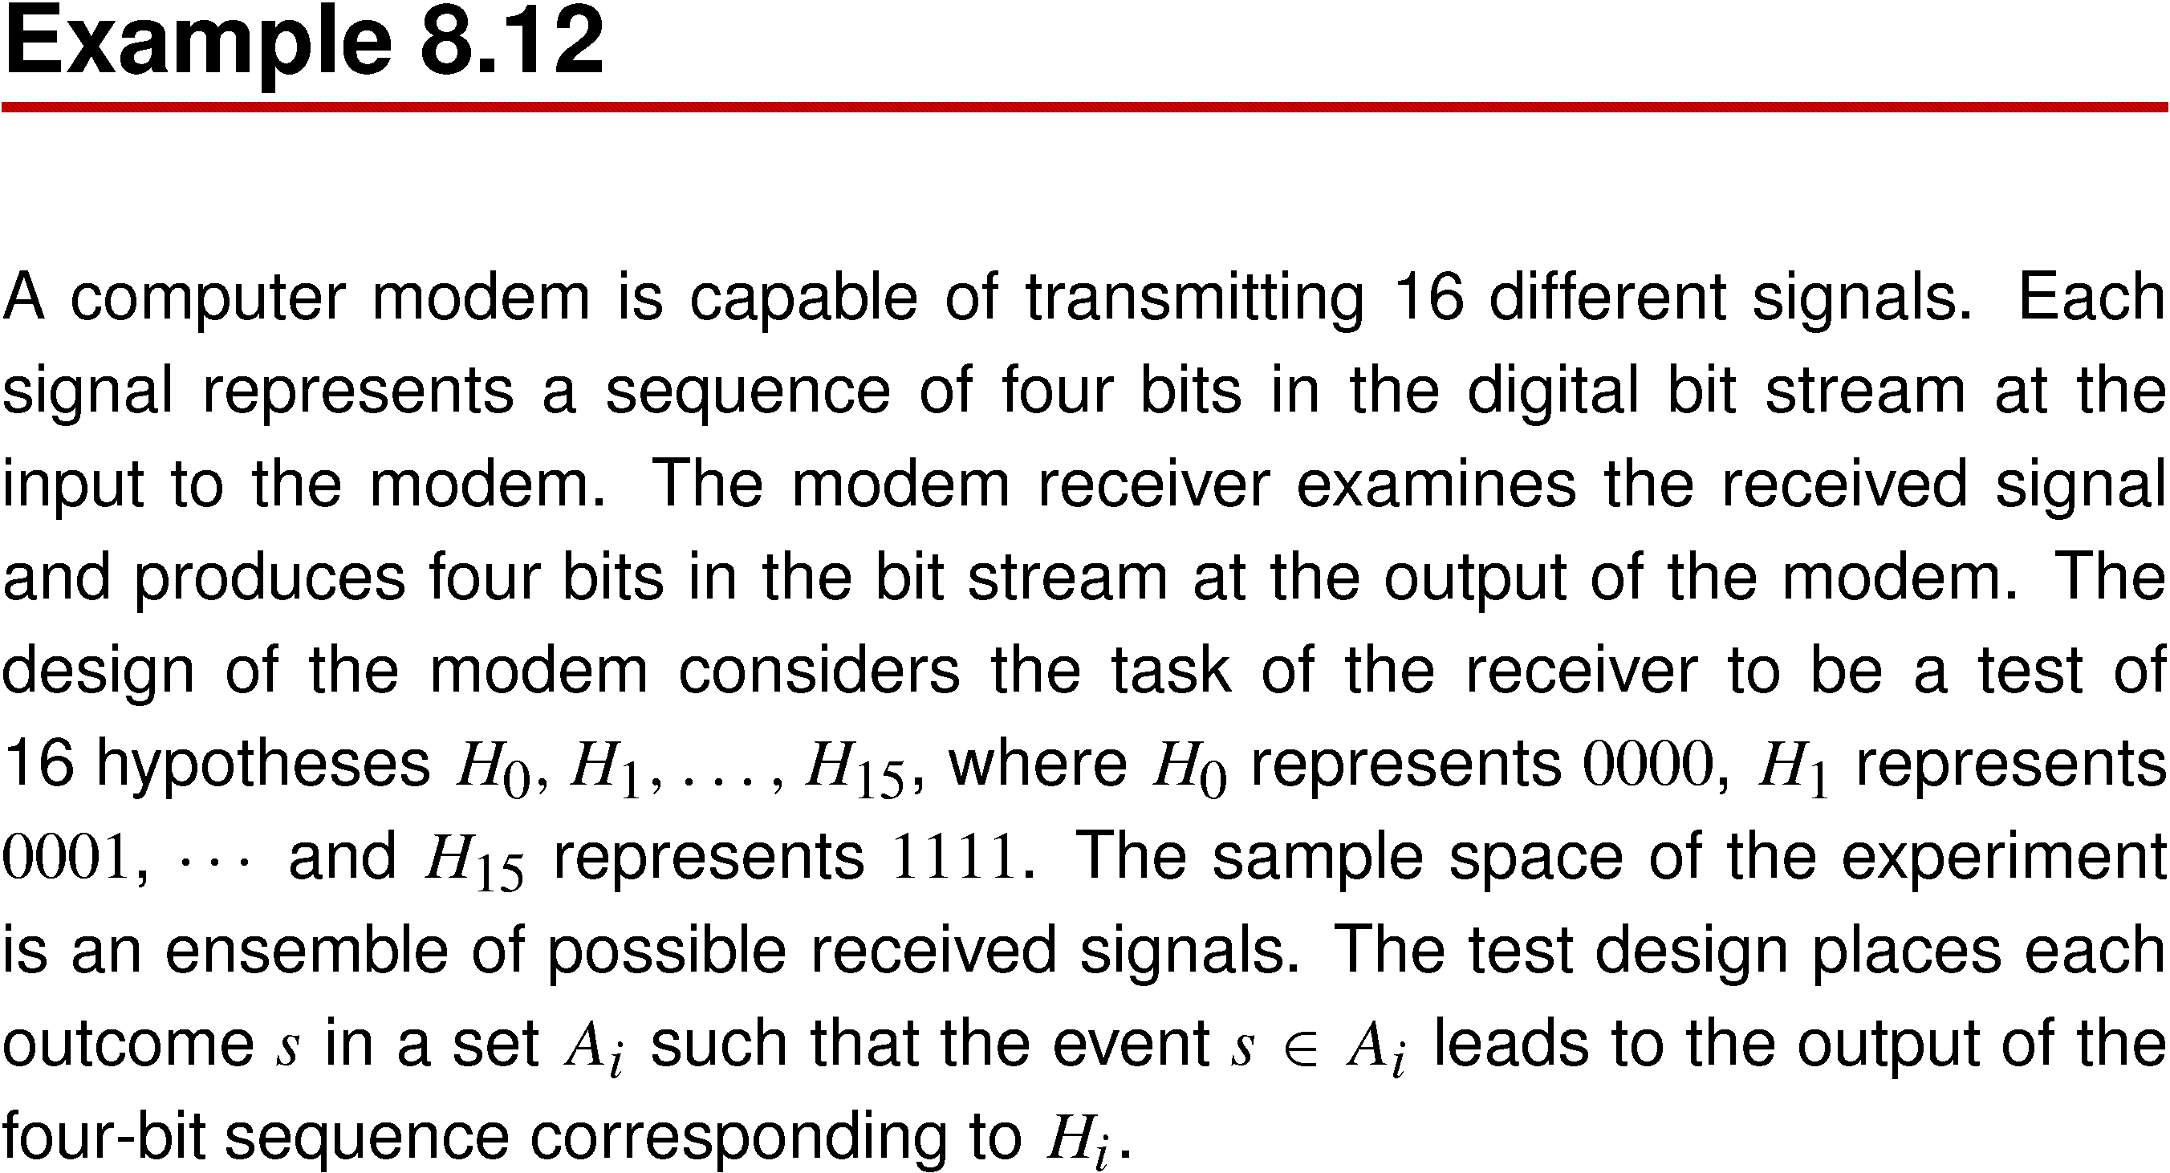
Example 8.12

Slide 78
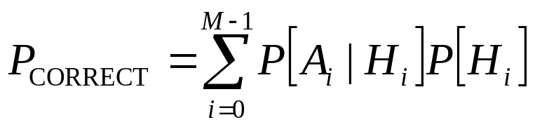
For a multiple hypothesis test, the MAP hypothesis test and the ML hypothesis test are generalizations of the tests in Theorem 8.1 and Definition 8.1. Minimizing the probability of error corresponds to maximizing the probability of a correct decision,

Slide 79
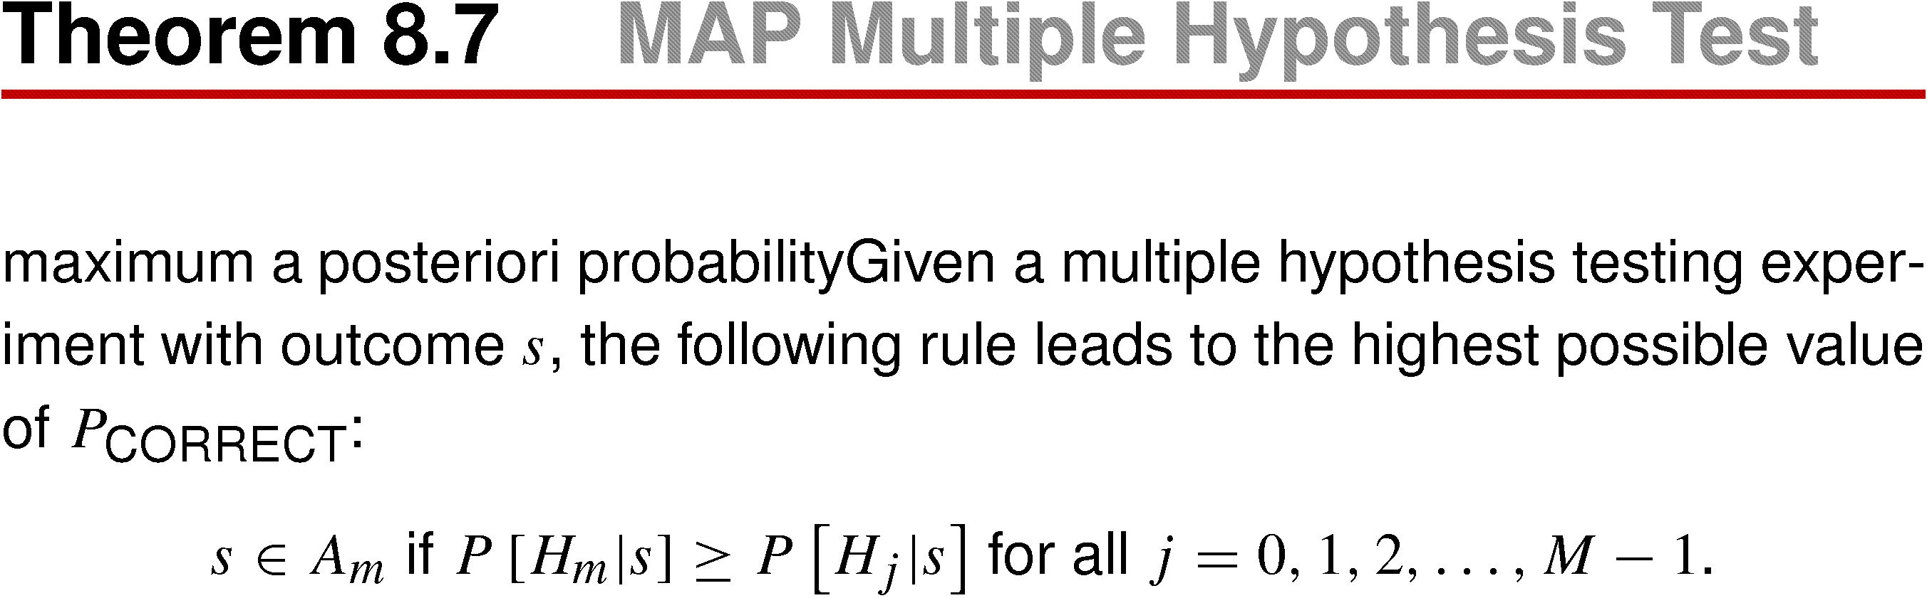
Theorem 8.7 MAP Multiple Hypothesis Test

Slide 80
As in binary hypothesis testing, we can apply Bayes’ theorem to derive a decision rule based on the probability models (likelihood functions) corresponding to the hypotheses and the a priori probabilities of the hypotheses.
Therefore, corresponding to Theorem 8.2 we have the following generalization of the MAP binary hypothesis test.

Slide 81
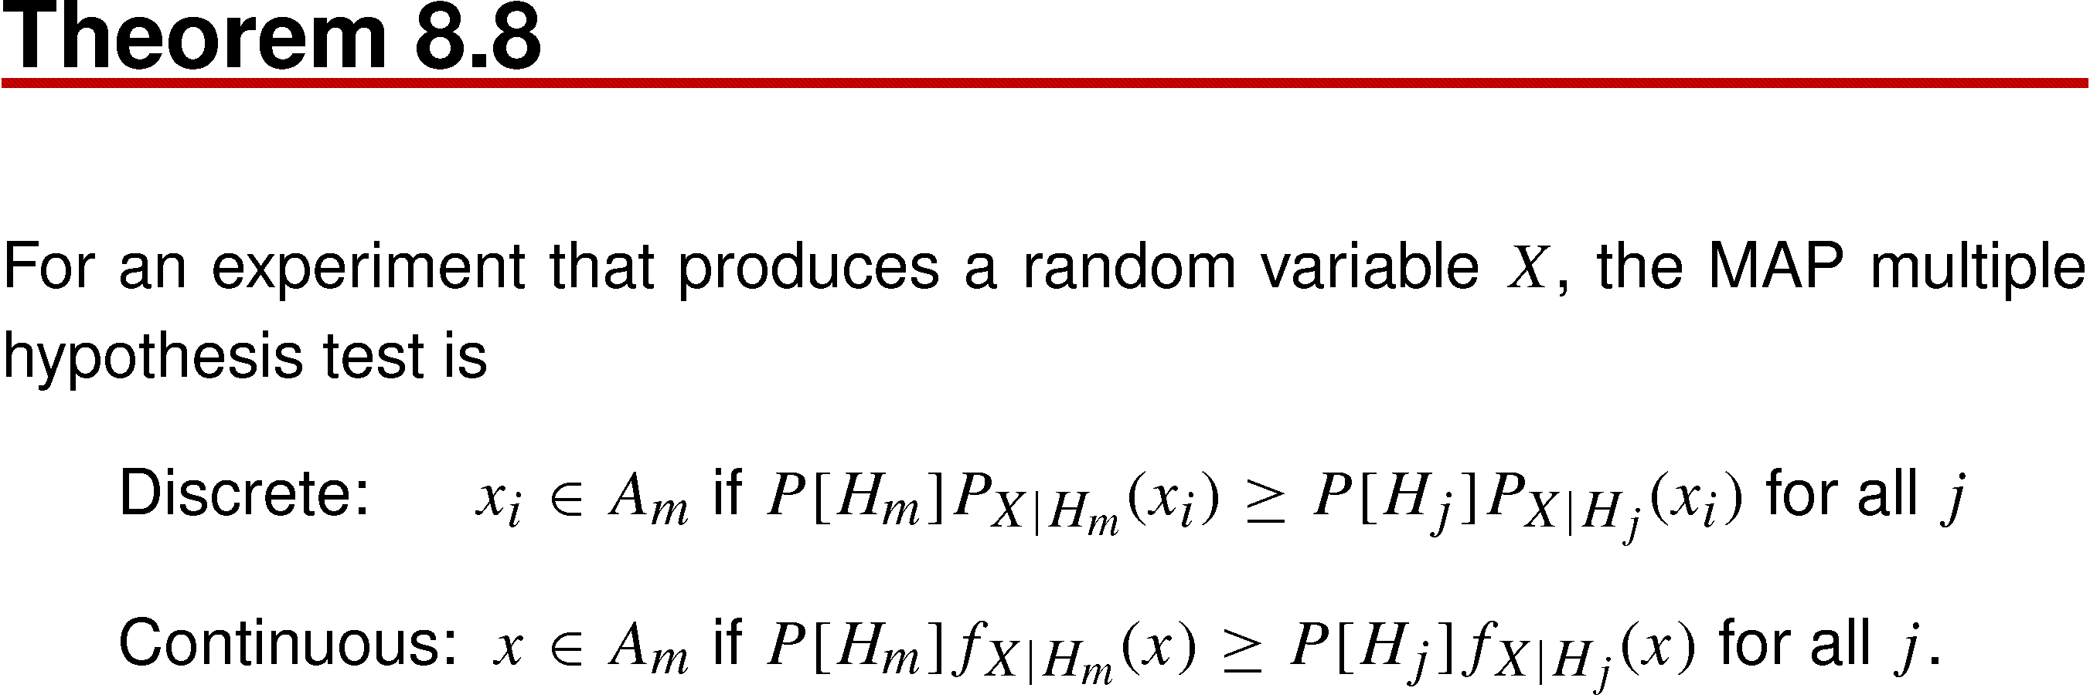
Theorem 8.8

Slide 82

Definition 8.2 Maximum Likelihood (ML) Multiple Hypothesis Test
If information about the a priori probabilities of the hypotheses is not available, a maximum likelihood hypothesis test is appropriate.
The ML hypothesis test corresponds to the MAP hypothesis test when all hypotheses H_{i} have equal probability.

Slide 83

Example 8.13
(QPSK)

Slide 84

Example 8.13 Solution

Slide 85

Example 8.13 Solution (continued)

Slide 86

Figure 8.4

Slide 87

Quiz 8.3

Slide 88

Quiz 8.3 Solution

